Slide 1
Great Britain.

Slide 2
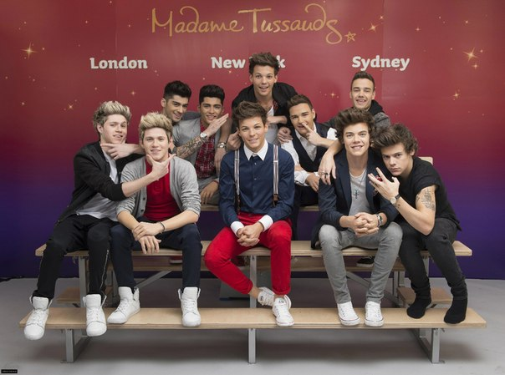
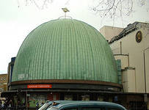
Madame Tussaud's wax Museum in London Marylebone, with branches in 14 cities (as of 2013), Amsterdam, Las Vegas, New York, Los Angeles, Hong Kong, Shanghai, Washington, Vienna and Berlin. It was established by the sculptor Maria Tussauds.

Slide 3
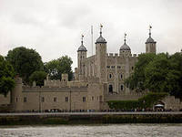
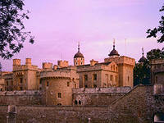
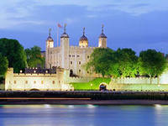
The Tower of London is the most famous of all the historical buildings in London. It stands today almost unchanged since it was built in the 11th century. In the past the Tower of London served both as a palace and as a state prison,, but it is a museum today.

Slide 4
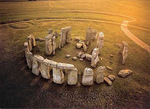
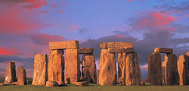
Mysterious stone megalith on Солсберийской plain included into the list of world heritage of UNESCO. The first researchers linked the construction of Stonehenge with druids. However, further excavations pushed the time of creation of Stonehenge to новокаменному and bronze ages.

Slide 5
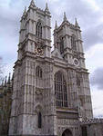
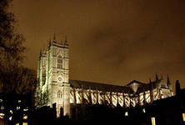
Westminster today, as many years ago, is the political centre of the UK, the place where solves the most important questions of life of the whole country. It was founded in the 7th century around existing then the monastery. The main part of the tourists first of all wants to see Buckingham Palace, houses of Parliament and Trafalgar square.

Slide 6
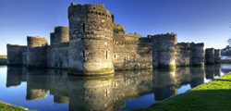
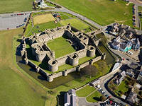
Bomaris - medieval castle, one of those that was built by king Edward I, to strengthen the position of England in Wales. It is believed that Bomaris virtually invulnerable to enemy, but check on the fact that this case was not forthcoming.

Slide 7
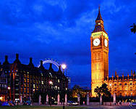
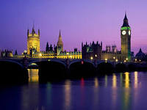
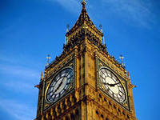
Big Ben is the main symbol of London and the bell tower of the Palace of Westminster, where he once lived members of the Royal family, and now direct the Affairs of members of the British monarchy parliament. A five-ton clockwork big Ben is considered to be the most accurate in the world.

Slide 8
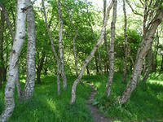
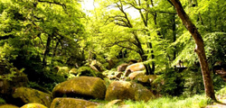
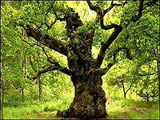
Near the village Edvinstou in the English County of Nottinghamshire is one of the most famous forests in the world - Sherwood forest. Of course, this landmark cannot be called a forest in the truest sense of the word, because the modern Sherwood still considered to be a Park area.

Slide 9
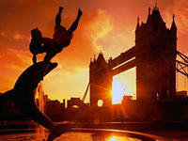
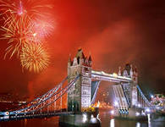
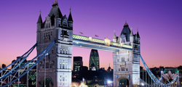
The issued symbol of London - tower bridge - was opened in 1984. He simultaneously and bascule and suspension. The design of the bridge is that when the lower Central span is bred for the passage of ships, the upper gallery of the remains open for pedestrians.

Slide 10
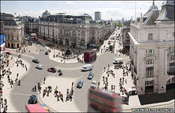
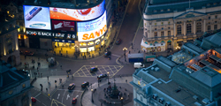
Street Piccadilly probably know even those who have never been to London, very often this is the place to mention in their works of writers, musicians and Directors. Piccadilly is one of the most colourful and vibrant streets in the historic centre of the city of Westminster.

Slide 11
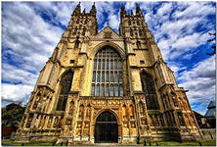
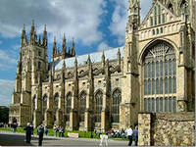
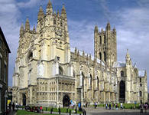
Canterbury Cathedral - the main Anglican Church of great Britain. One of the main attractions of the Canterbury Cathedral is considered painting «the Apostle Paul with a snake», a fragment of the painting of the chapel of Saint Anselm.

Slide 12
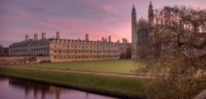
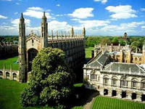
One of the oldest and largest English universities-the University of Cambridge was founded in 1209. Already in the 13th century in Cambridge formed Humanities, law, theology and medical faculties. Since then and to this day Cambridge in the world rankings of universities has consistently ranked high places, competing with Oxford for the title of best University.

