Slide 1
How English Became a Global Language
Выполнила Цховребова Зинаида Владимировна
Учитель английского языка ГБОУ СОШ №8 г.Беслан

Slide 2
INTRODUCTION
TOPICALITY OF RESEARCH is caused by increasing importance of the English language.
THE PURPOSE OF THE RESEARCH is to find out why the English language is extremely popular nowadays.
.

Slide 3
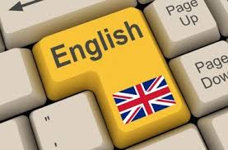
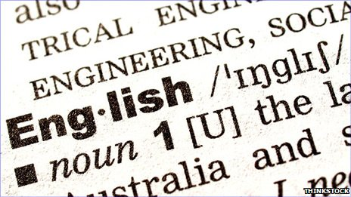
OBJECT OF RESEARCH:

Slide 4
SUBJECT OF RESEARCH-is to investigate the reasons how “a language that came from nowhere conquered the world”.

Slide 5
TASKS:
1.To find out the origin of the English language. Five invasions of Britain. Languages that contributed to English.
2.To discover why English was the language of commoners and French – the language of aristocrats and nobility during three centuries XI-XIV.
3.Still a provincial language in Shakespeare‘s time.
4.To find out reasons why English is becoming so popular.
5.To discover how many countries speak English.
6.The level of the English language in the Russian Federation.
7.The future of the world language.

Slide 6
A Source of Communication
Language is our primary source of communication. It's the method through which we share our ideas and thoughts with others.

Slide 7
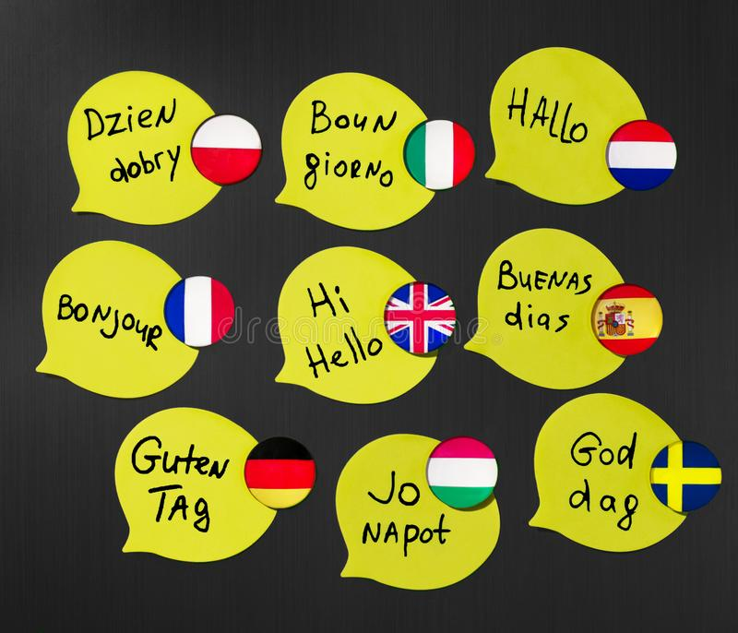
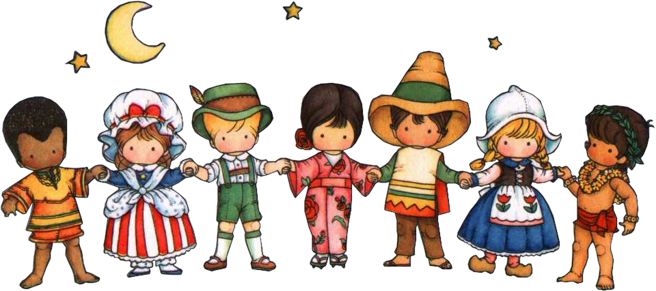
A Variety of Languages
There are about 3000 languages in the world. English is the richest among them. English has a vocabulary of about 500 000 words, German- 185 000, French-100 000.
Some languages are spoken by millions of people, others by only a few thousand.

Slide 8
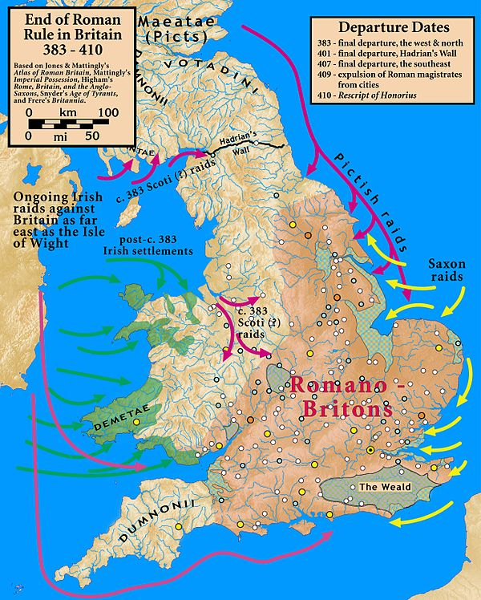
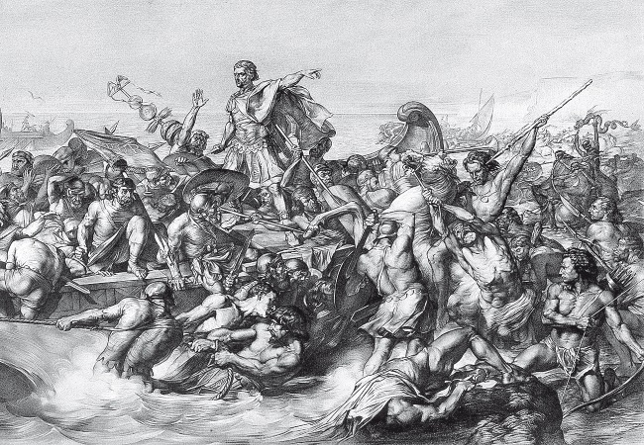
The Rise of English
The rise of English is a remarkable success story. When Julius Caesar landed in Britain nearly two thousand years ago, English did not exist.

Slide 9
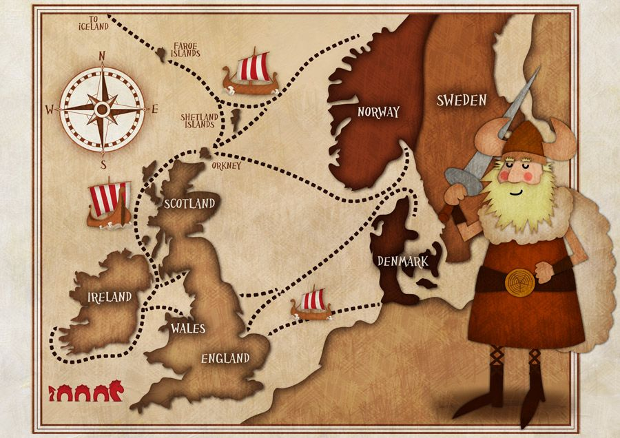
Five Invasions of the British Isles
Invasions of the British Isles have occurred throughout history. Various sovereign states within the British Isles were invaded several times; by the Romans, Germanic peoples, Vikings and Norsemen who came from Sweden, Denmark and Norway, the French and the Dutch.

Slide 10
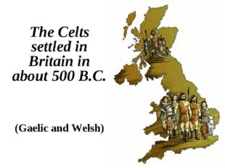
The First Invasion of Britain
The first invasion took place in 400 BC when Celts armed with iron weapons conquered Kent and much of Southern England. They spread north and imposed their language on them. The most important Celtic words in modern English are names of places, especially in Scotland and Ireland. Aberdeen ( from aber – mouth) Dunbar, Dundee (from dun – a protected place) Kilkeny (from kil - church); and a few common words such as bog, crag, willow.

Slide 11
Contribution of the Celtic Language
It is very strange, but the Celtic language didn't contribute many words to modern English. They mostly describe the household and family being: lord, lady, bread, cow etc. We can find Celtic words in the names of places and rivers such as: Dover, Kent, Avon and the Thames, for example.

Slide 12
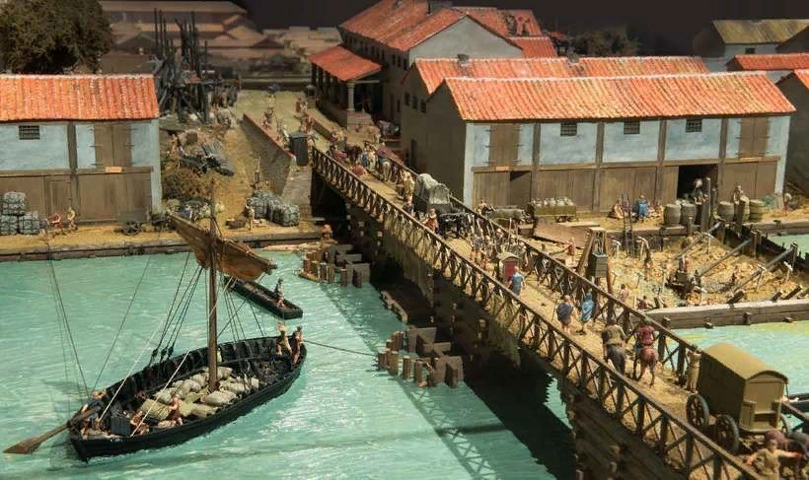
The Second Invasion of Britain
The Romans left behind them memories of camps, roads, and military colonies in such endings in geographical names, as -caster, -cester or -chester (from castra - camp), -coln (from colonia), the words street (from strata), mile (from millia passuum - a thousand paces)
Manchester, Lancaster Chester, Rochester

Slide 13
The Anglo-Saxons contributed to the formation of English most of all
The history of the English language really started with the arrival of three Germanic tribes who invaded Britain during the 5th century AD. These tribes, the Angles, the Saxons and the Jutes, crossed the North Sea from what today is Denmark and northern Germany.

Slide 14
The Fourth Invasion of Britain by the Vikings
In the 9th century the Vikings terrified the Anglo-Saxons as much as they themselves had terrified the Britons centuries before. They were people from Scandinavia whose life was working the land and fishing and who went on to attack and later settle in Britain.
The Vikings added many Norse words: sky, egg, cake, leg, window, husband, skill, anger, flat, ugly, get, give, take, raise, call, die, they, their, them.

Slide 15
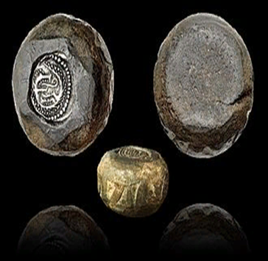
The Vikings contribution to the formation of English
The Viking contribution to the English language is astonishing.
A lot of words were brought from Old-Scandinavian. The verb “get” and the words beginning with “sk”- sky, ski, skip, skate, skin, skill and others.
Rake – грабли, scare –пугать, sly – хитрый, weak – слабый, ugly – уродливый, happy-счастливый, knife – нож, awkward – неудобный, drown – тонуть, life – жизнь, dirt – грязь…

Slide 16
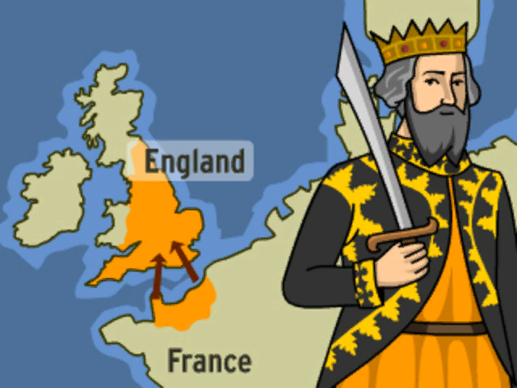
The Fifth Invasion of Britain-Norman’s Conquest of Britain
The Norman Conquest was the fifth and the last invasion of Britain. And it is so well-known because it was On October 14th, 1066, King William (Duke of Normandy) defeated the army of the English King Harold in the Battle of Hastings.
For three centuries (XI-XIV), these two languages ​​competed with each other. French clearly dominated, introducing new vocabulary into English.

Slide 17
Words of Anglo-Saxon Origin
Words of Anglo-Saxon origin are simple, short and direct. Here are a few of them:
give, gold, good, great, have, high, hire, hold, home, house, husband, idle, if, keep, knife, knit, lade, land, last, late, laugh, law, lay, lend, load, loan, long, look, low, mad, make, man, match, mate, might, mother, new, old, pride, put, read, rent, right, roof, sell, send, settle, sharp, shelter, ship, shop, short, silver,

Slide 18
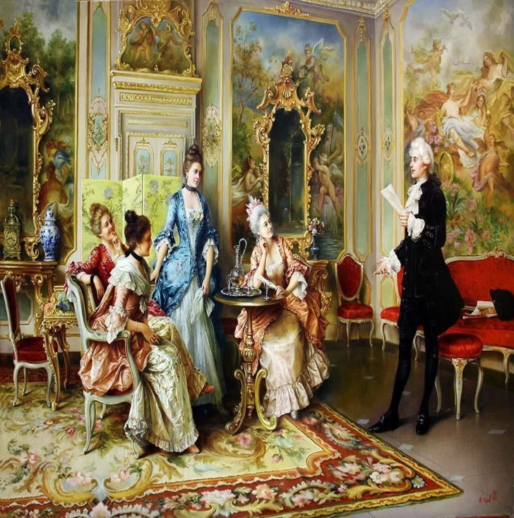
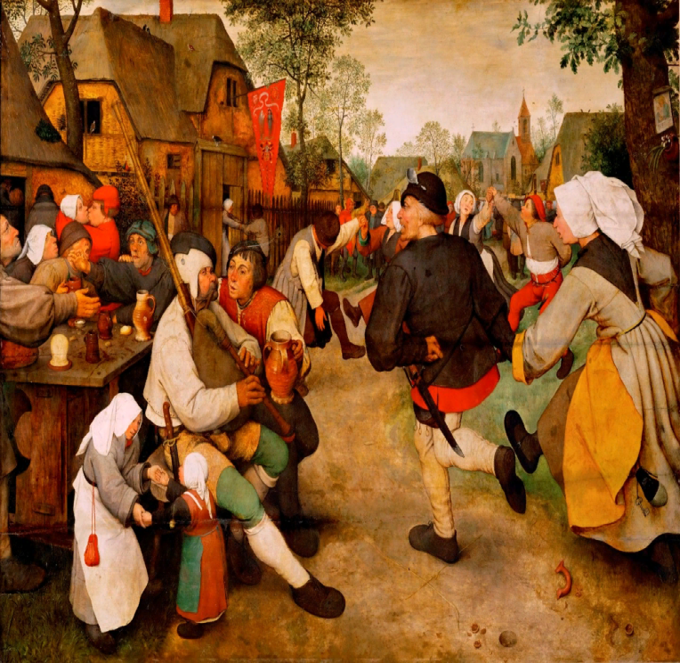
English- the Language of Commoners
The history of the French language in English began in 1066 after the Normans conquered England. It was then that the language of the nobility became French, and the language of commoners - English.

Slide 19
The English Alphabet
The English alphabet came from Latin. Christian monks, who spoke Latin, brought it to England from Ireland.

Slide 20
A “provincial language”
Only in the course of the last hundred years that English has become a world language. In Shakespeare's time it was a "provincial" language of secondary importance with only 6 million native speakers.

Slide 21
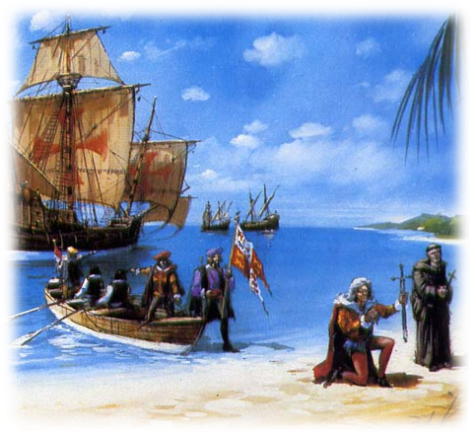
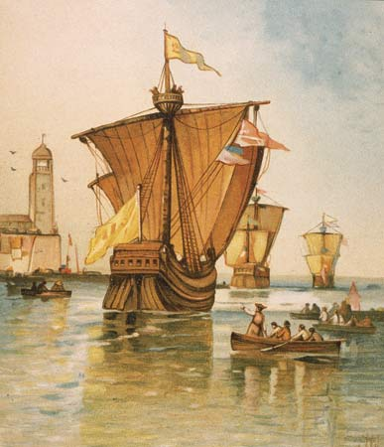
Taken Around the World
After developing for almost a millennium on the British Isles, English was taken around the world by the sailors, soldiers, pilgrims, traders and missionaries of the British Empire.
English is like many European languages and that's why people can learn it easily.

Slide 22
The World Language
In the 21st century English has become the language of the planet. It is the first truly global language. Three quarters of the world’s mail is in English. More than 50% of the scientific periodicals and 80% of the information in the world’s computers are also in English.

Slide 23
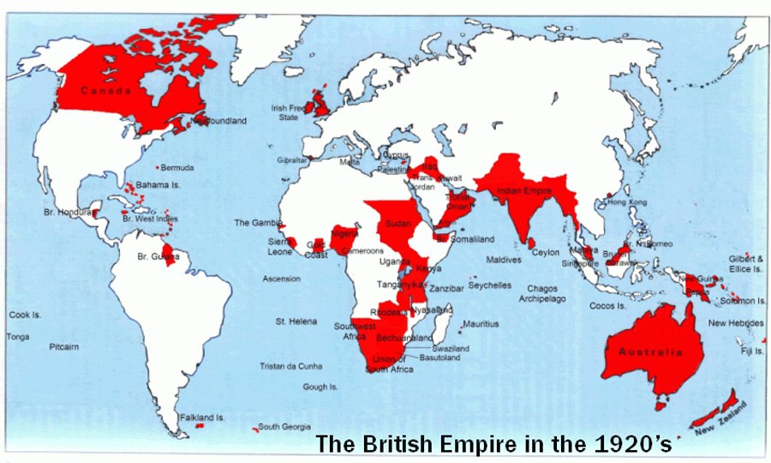
The Language of Colonies
During the 17th and 18th centuries, British navigators sailed across the seas with the aim of extending Britain’s power and prosperity. They colonized new territories around the world, taking their language with them. English was imposed as the official language of the new colonies.

Slide 25
The domination of English
Geographically, English is the most widespread language on Earth, second only to Mandarin Chinese in the number of people who speak it. English is also more widely written than any other language.

Slide 26
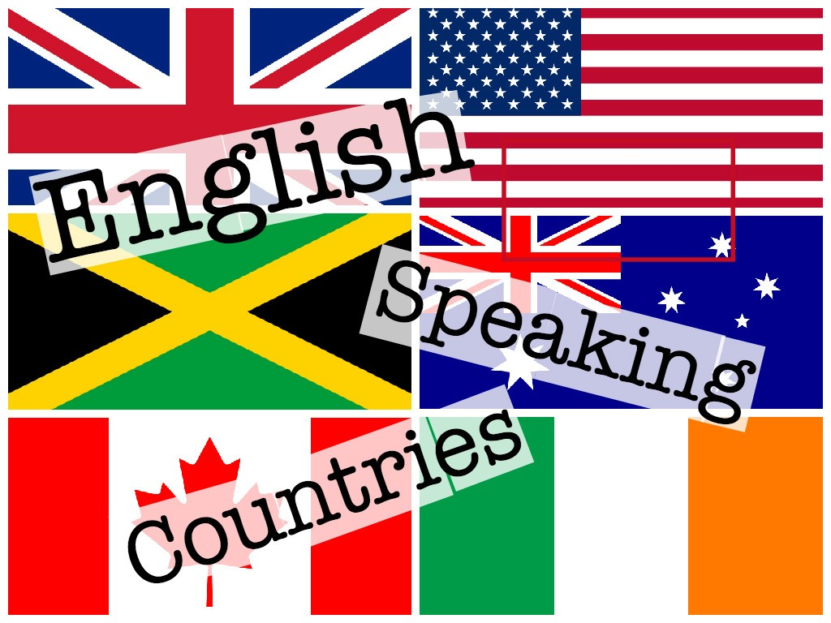
The Official Language
English is the official language in some countries that means that it is used in government, in schools.
English is the official language of the UK, the USA, Canada, Australia and New Zealand.

Slide 27
English as a Native Language
More than 300 million people speak English as a native language. Most of them live in North America,Сanada the British Isles, Australia, New Zealand, the Caribbean, and South Africa.

Slide 28
ESL and EFL
There are 750 million English as a foreign language speakers(EFL) and 375 million English as second language learners (ESL). The difference between the two groups is that EFL speakers generally are those using English occasionally for business or pleasure, while ESL students use English on a daily basis.
As a second language English is spoken in more than 60 countries. It is used by the government, businessmen and universities.

Slide 29
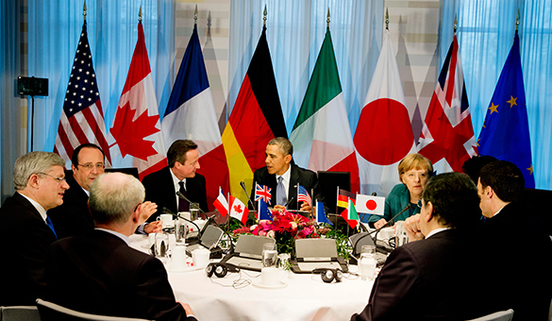
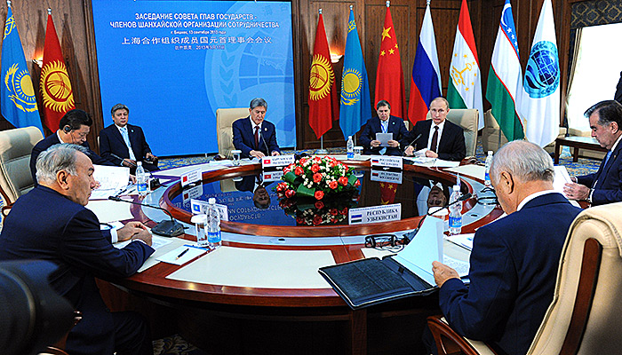
The Language of Diplomacy
The domination of the English language globally is undeniable.
English is the language of politics and diplomacy and international communications.
English is used to solve different world problems.

Slide 30
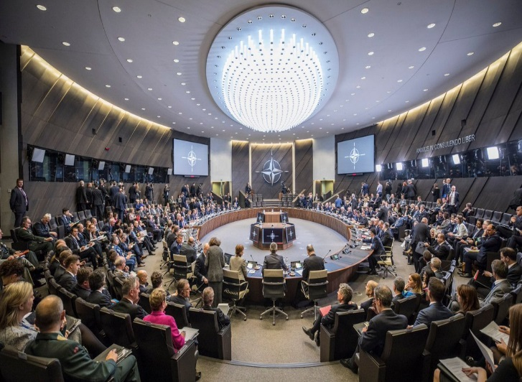
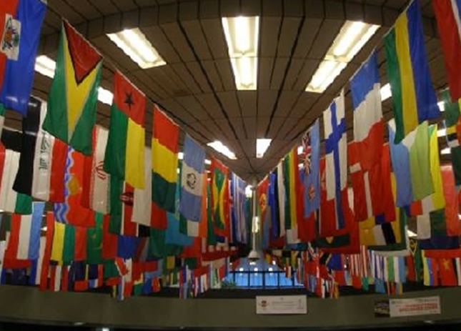
The Language of NATO and the United Nations
The working languages of the United Nations are English and French. All documents are written only in the working languages.

Slide 31
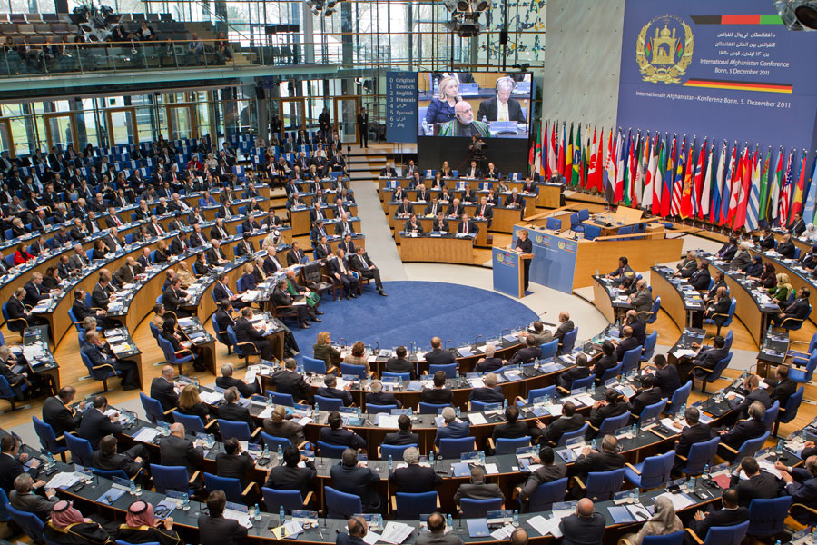
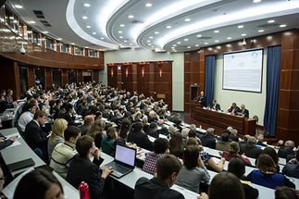
The Language of Science and Technology
For academicians , scientists and doctors to know English is a must.
All international and scientific conferences and summits are also in English.
Nowadays when science and technology are progressing so fast all kind of specialists need English in their work.

Slide 32
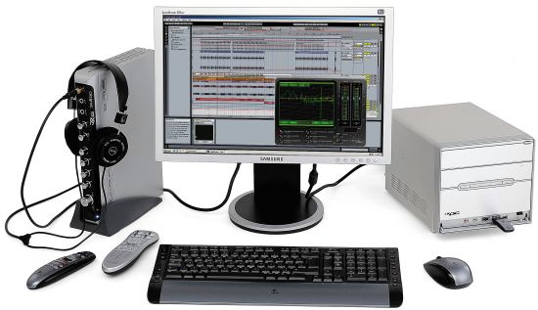
The Language of Computers and the Net
80% of all information in the world's computers is in English. 75% of the world's letters and faxes are in English

Slide 33
The language of Business
English is the chief language of international business. Almost all multi-national companies do business in English. When a German company director meets a customer from Greece to discuss a new project and to sign a contract, they talk to each other in English.

Slide 34
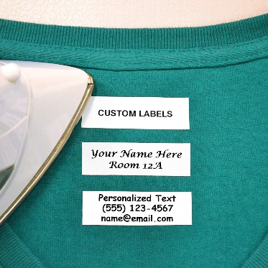
The Language of Labels
Everywhere industrial companies label their products in English. It is not because Britain and the United States are the biggest export markets in the world, but because English has become an international language.
Nowadays when science and technology are progressing so fast all kind of specialists need English in their work.

Slide 35
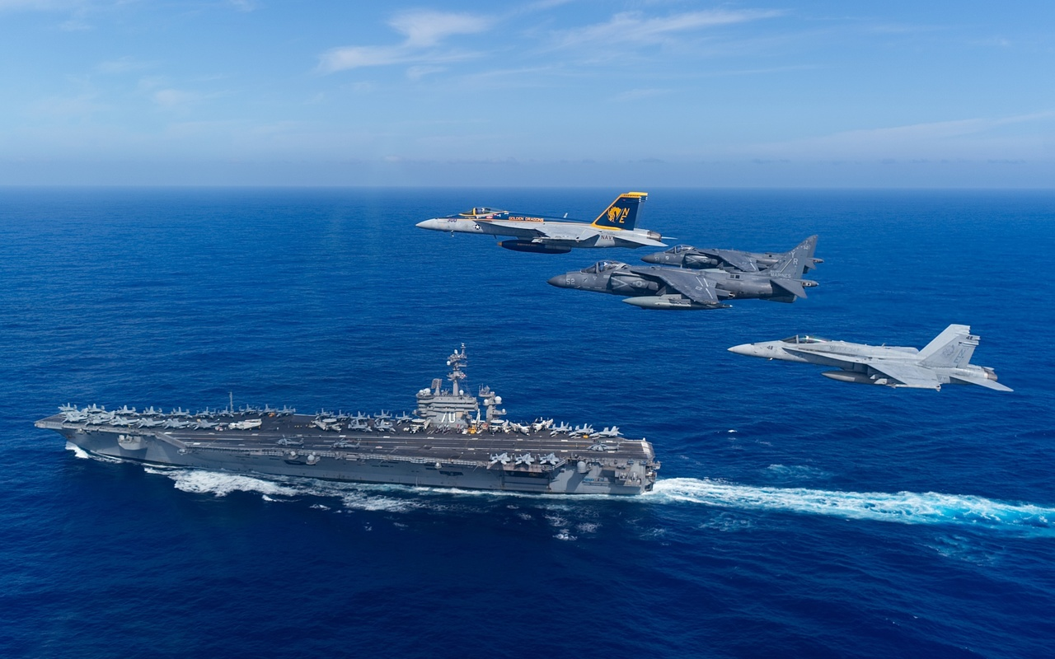
The Language of “the Sky and the Sea”
Certain “international” professions, such as airline pilots and air-traffic controllers require a working knowledge of English. Every pilot and ship captain must speak English to communicate with each other.

Slide 36
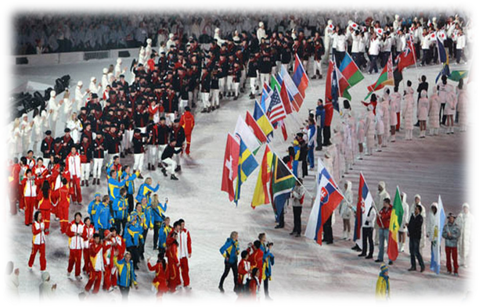
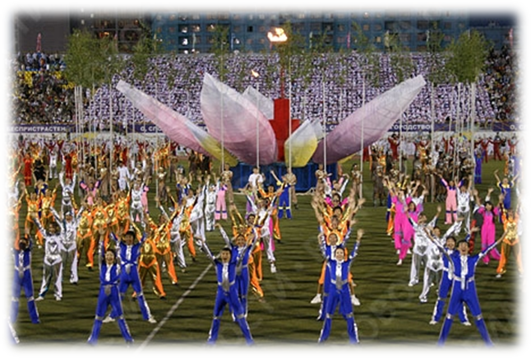
The Language of Sport
English is the language of sports: the official language of the Olympics.

Slide 37
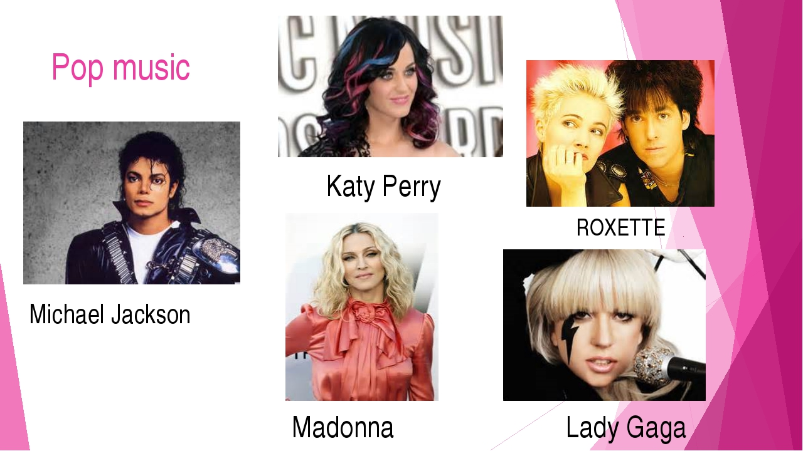
The Language of Pop Music
English is also the language of pop culture, advertising and entertainment.
Even non-native English speakers have at least a couple of songs in English.

Slide 38
The Language of Communication
English has become now the language of international communication.
Everyone will speak English soon — I'm sure of it. We all need to understand each other. To do that we need an international language, and that's English.

Slide 39
The Language of Media
English is the language of the media industry.
More than 60% of all scientific journals are written in English.
80% of all information in the world's computers is in English. 75% of the world's letters and faxes are in English. 60% of all international telephone calls are made in English.

Slide 40
A Must For Travelling
A person who has a good command of English feels at ease not only in his native country but abroad too.
I firmly believe that travelling is a wonderful opportunity to see the world and to understand your own country deeper. Travelling broadens our mind and is a really exiting activity. And English helps greatly wherever we go.

Slide 41
The Language to Get a Good Job
To know English today is absolutely necessary for every educated person, for every good specialist. Knowing English helps greatly to find a well-paid job and move up the career ladder.

Slide 43
According to the research Russia takes 31 position in the world.
So we can state that level of the English language in the Russian Federation is rather low.

Slide 45
Why did English become a world language?
1.English is the easiest language to learn.
2.English is a mother tongue of about 400 million people.
3.English is the second language of 1 billion people.
4.English is a foreign language of
5.English is the international language of many industries, including banking, business, diplomacy and even entertainment.

Slide 48
Nothing is impossible. The word itself says “I’m possible!”

Slide 50
The recent research has shown that the British Council predicts within five years about half of world’s population –over 3.5 billion people will speak English.

Slide 51
Conclusion
Languages and borders change over time, but, to my mind, English is likely to remain the world’s number one language during our century.

Slide 52
Используемый интернет –ресурс:
http://englishschool12.ru/load/english_as_a_world_language_countries_languages/6-1-0-208
http://www.youtube.com/watch?v=OwQNFaID1Iw (Видео стран где говорят на английском)

