Slide 1
Урок Английского языка в 4 классе
УМК “ Enjoy English”

Slide 2
Is it sunny?

Slide 3
Is it rainy?

Slide 4
Is it snowy?

Slide 5
Is it foggy?

Slide 6
Is it windy?

Slide 7
Is it hot?

Slide 8
Is it cloudy?

Slide 9
Is it cold?

Slide 10
THERE IS NO BAD WEATHER, THERE ARE ONLY BAD CLOTHES (не бывает плохой погоды, бывает плохая одежда)

Slide 11
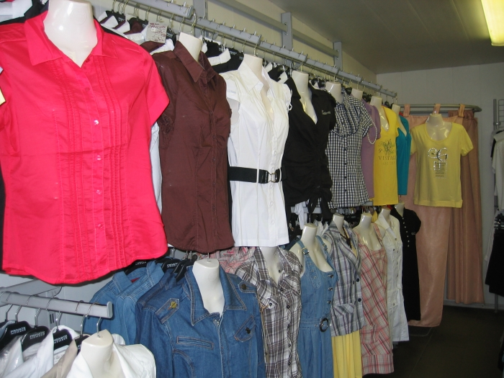

Slide 12
Тема урока: Clothes Цель нашего урока:
- познакомиться с новыми словами обозначающими «одежду»
- научиться вести диалог между покупателем и продавцом в магазине.

Slide 13
Listen and read!

Slide 14
Listen and read!
[⌠]
Shirt
t-shirt
shoes
shorts
[е]
red
help
dress
sweater
[u:]
room
blue
boots
shoes

Slide 15
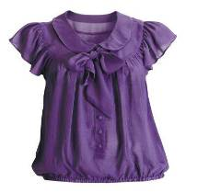
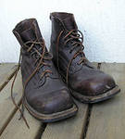
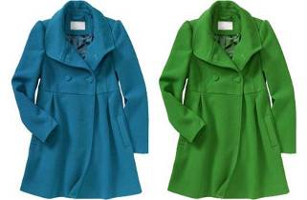
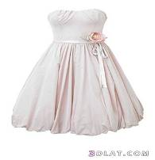
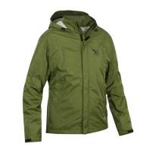
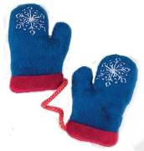
Clothes
blouse boots coat
dress jacket jeans mittens

Slide 16
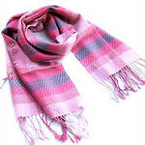
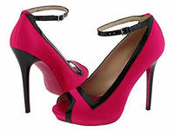
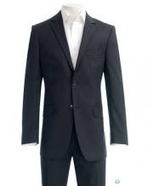
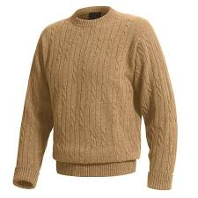
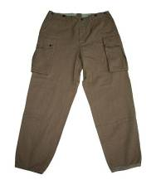
scarf shoes suit
sweater trousers t-shirt

Slide 17
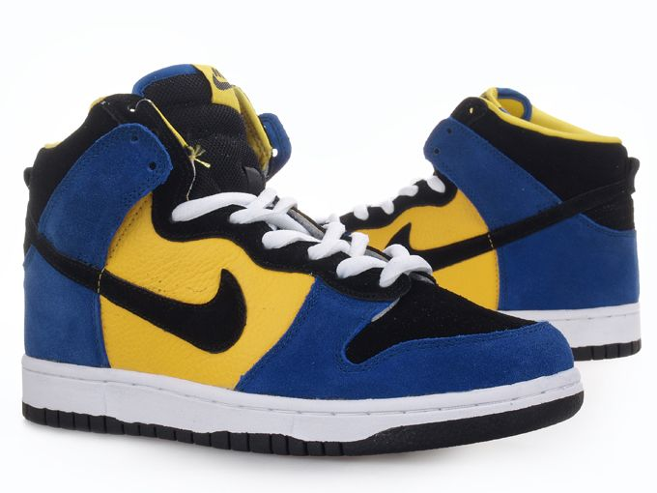
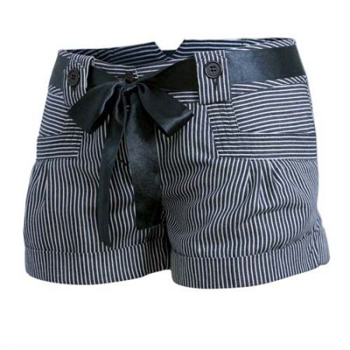
raincoat trainers shorts

Slide 18
Let’s do ex.1 page 85
Example: She has got a scarf in the shop.

Slide 19
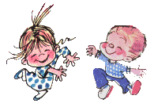
The Song “Clap your hands
1. Clap your hands, clap your hands
Listen to the music and clap your hands
2. Stamp your feet, stamp your feet
Listen to the music and stamp your feet
3. Turn around, turn around
Listen to the music and turn around
4. Jump up high, jump up high
Listen to the music and jump up high

Slide 20
Name the clothes in alphabetical order.
Blouse
Boots
Coat
Dress
Jacket
Jeans
Mittens
Raincoat
Scarf
Shoes
Suit
Sweater
Trousers
T – shirt

Slide 21
Read dialogue. Pay attention to these phrases.
to suit anybody – устраивать кого – либо
size – размер
pound – фунт
to show – показать
how much is it –сколько стоит?

Slide 22
Use these phrases.
Can I help you?
Here you are.
Anything else!
How much is it?
I would like to pay/to buy.
No that is all.

Slide 23
Example:
Hello!
Hello!
Can I help you?
I would like to buy a t – shirt.
What colour?
Yellow, please.
Does it suit me?
It looks very good.
How much is it?
10 pounds.
Anything else?
No, thank you. That is all. Here you are.
Thank you!
Good bye!

Slide 24
Homework
In your Student’s Book:
- ex.1 p.96 - ex.2 p. 96
- Learn new words “Clothes”

Slide 25
Рефлексия -понял весь материал -понял , не весь материал -не понял ничего

Slide 26
Thank you for lesson!
Good bye!

Slide 27
Используемые ресурсы
http://images.yandex.ru/yandsearch?text=blouse&fp=0&pos=1&uinfo=ww-1349-wh-624-fw-1124-fh-448-pd-1&rpt=simage&family=yes&img_url=http%3A%2F%2Flipsticklifestyle.com%2Fwp-content%2Fuploads%2Fhm-purple-blouse.jpg блузка
http://images.yandex.ru/yandsearch?text=boots&fp=0&pos=7&uinfo=ww-1349-wh-624-fw-1124-fh-448-pd-1&rpt=simage&family=yes&img_url=http%3A%2F%2Fupload.wikimedia.org%2Fwikipedia%2Fcommons%2Fthumb%2F9%2F96%2FArmy-boots.jpg%2F220px-Army-boots.jpg ботинки
http://images.yandex.ru/yandsearch?text=coat&fp=0&pos=3&uinfo=ww-1349-wh-624-fw-1124-fh-448-pd-1&rpt=simage&family=yes&img_url=http%3A%2F%2Fwoman-cafe.ru%2Fwp-content%2Fuploads%2F2012%2F02%2Fzhenskie-polushubki.jpg плащ
http://images.yandex.ru/yandsearch?text=dress&fp=0&pos=2&uinfo=ww-1349-wh-624-fw-1124-fh-448-pd-1&rpt=simage&family=yes&img_url=http%3A%2F%2Fwww.weddingo.co.uk%2Fwp-content%2Fuploads%2F2009%2F01%2Fbirdsong-dress.jpg платье
http://images.yandex.ru/yandsearch?text=jacket&fp=0&pos=22&uinfo=ww-1349-wh-624-fw-1124-fh-448-pd-1&rpt=simage&family=yes&img_url=http%3A%2F%2Fimages.internetstores.de%2Fproducts%2Fsalewa_aqua_m_red%5B1024x768%5D.JPG

Slide 28
http://images.yandex.ru/yandsearch?text=jeans&fp=0&pos=11&uinfo=ww-1349-wh-624-fw-1124-fh-448-pd-1&rpt=simage&family=yes&img_url=http%3A%2F%2Fupload.wikimedia.org%2Fwikipedia%2Fcommons%2Fthumb%2F9%2F92%2FDenimjeans2.JPG%2F370px-Denimjeans2.JPG джинсы
http://images.yandex.ru/yandsearch?text=mittens&fp=0&pos=0&uinfo=ww-1349-wh-624-fw-1124-fh-448-pd-1&rpt=simage&family=yes&img_url=http%3A%2F%2Fwww.callingalldogs.com%2FProductImages%2Ftoys%2FMittens300.jpg варежки
http://images.yandex.ru/yandsearch?text=scarf&fp=0&pos=0&uinfo=ww-1349-wh-624-fw-1124-fh-448-pd-1&rpt=simage&family=yes&img_url=http%3A%2F%2Fsaat.bbs.tr%2Fpromosyon_tekstil%2Fatki-imalat%2Fatki-imalat04.jpg шарф
http://images.yandex.ru/yandsearch?text=shoes&fp=0&pos=4&uinfo=ww-1349-wh-624-fw-1124-fh-448-pd-1&rpt=simage&family=yes&img_url=http%3A%2F%2Fwww.millionlooks.com%2Fimages%2Falexander_mcqueen_shoes.jpg туфли
http://images.yandex.ru/yandsearch?text=suit&fp=0&pos=3&uinfo=ww-1349-wh-624-fw-1124-fh-448-pd-1&rpt=simage&family=yes&img_url=http%3A%2F%2Fodessa.link.ua%2Fvar%2Fboard_photo%2F272_96031_link.ua_pr.jpg костюм
http://images.yandex.ru/yandsearch?text=sweater&fp=0&pos=0&uinfo=ww-1349-wh-624-fw-1124-fh-448-pd-1&rpt=simage&family=yes&img_url=http%3A%2F%2Fimg1.exportersindia.com%2Fproduct_images%2Fbc-small%2Fdir_19%2F558697%2Fmens-sweater-01-256503.jpg свитер
http://images.yandex.ru/yandsearch?text=trousers&fp=0&pos=0&uinfo=ww-1349-wh-624-fw-1124-fh-448-pd-1&rpt=simage&family=yes&img_url=http%3A%2F%2F2.imimg.com%2Fdata2%2FVI%2FRA%2FMY-2939855%2Fem_trousers_03-125x125.jpg штаны
http://images.yandex.ru/yandsearch?text=t-shirt&fp=0&pos=9&uinfo=ww-1349-wh-624-fw-1124-fh-448-pd-1&rpt=simage&family=yes&img_url=http%3A%2F%2Fwww.2dayblog.com%2Fimages%2Fdigital_shirt.jpg футболка

