Slide 1


Slide 2
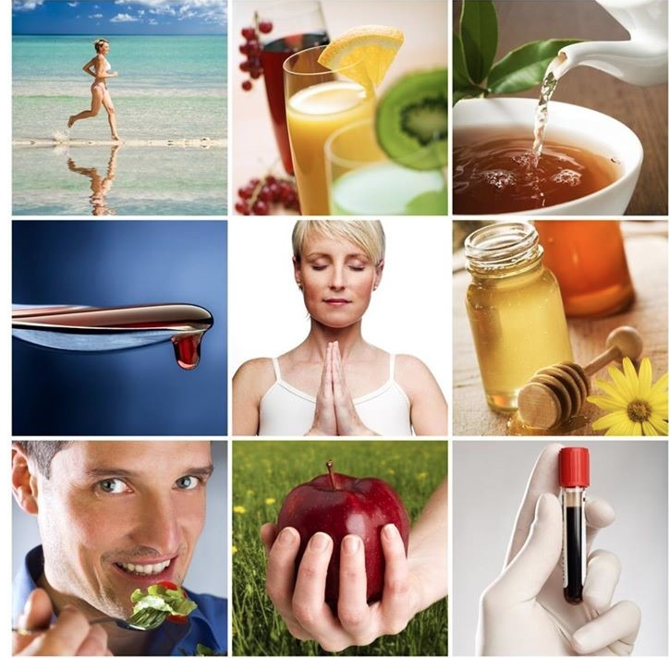


Slide 3

How to stay healthy?

Slide 4
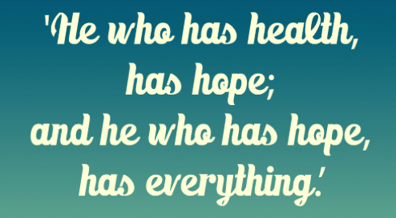
Thomas Carlyle(British writer and philosopher)

Slide 5


Answer the questions
1.Why has Ann written the letter?
2. Does Ann lead a healty lifestyle? Prove it.
3. What do you think Ann's lifestyle was before?
to pay attention to - обращать внимание на
to limit - ограничивать
to avoid - избегать
junk food - нездоровая еда
to ban - запрещать

Slide 6
Units 1-2 (Vocabulary)
to pay attention to
both … and …
to limit
used to
to avoid
neither … nor …
junk food
either … or …
to ban
нездоровая еда
или …или …
запрещать
ни … ни …
обращать внимание
и … и …
избегать
обычно, бывало
ограничивать

Slide 7
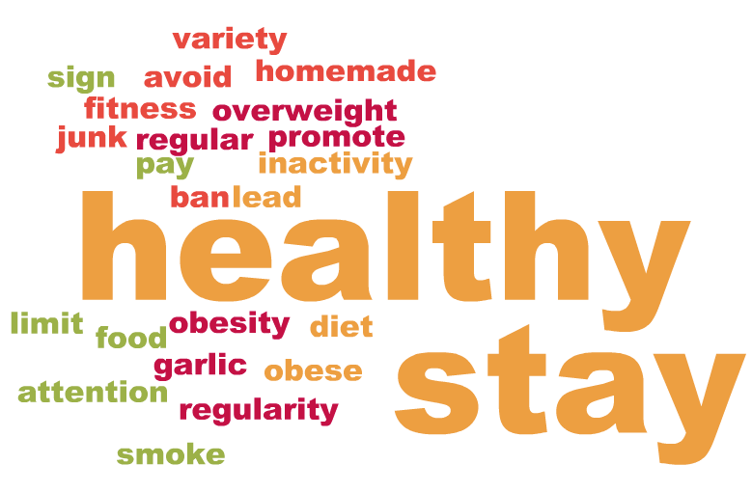
On cloud nine.
Positive words
2. Negative words
3. Our today’s motto

Slide 8

Acrostic poem
Stay
H
E
A
L
T
H
Y

Slide 9


Are you tired?
No
Yes

Slide 10


Slide 11
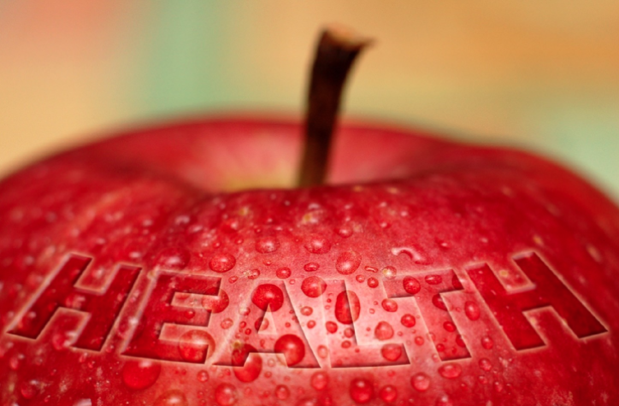


Slide 12
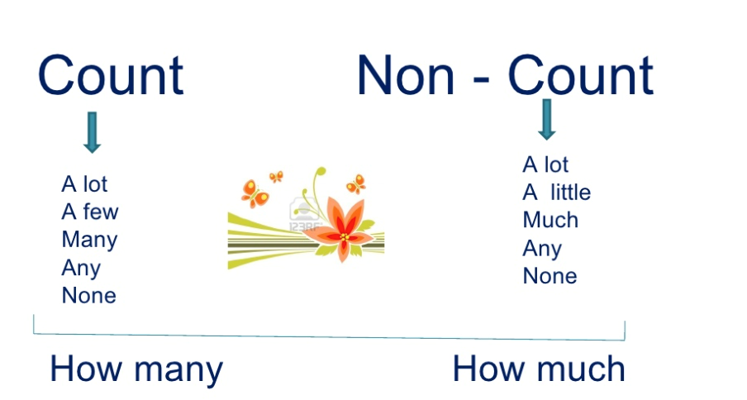

Quantifiers
Количественные местоимения
Countable
Uncountable

Slide 13

Activity Book ex.2 p.65
Criteria for marks
little
many
not much
a lot of
much
a lot of
a few
much
a lot of
a little
10 – 9 – 5
8 – 6 – 4
5 – 4 – 3
3 – 0 – 2

Slide 14


To sum it up
Was there anything new for you today?
What was the most interesting, and the most difficult for you?
kudryashka_inga@mail.ru,
instagram #howtobehealthy
Hometask:
1. Words p. 152, Unit 5, Lesson 2
2. Grammar p. 191-192 (The Infinitive) 3. A.B. Unit 5, Lesson 2, ex.1

Slide 15

STAY HEALTHY!
Thank you for your attention.
Have a nice day)

