Slide 1
Turkestan Region,
Kazygurt,
School named after K.Satbayev
Theme: “Motivating Students through Formative Assessment”
Prepared by: Abdullayeva Zhuldyz Sattarkyzy

Slide 2
Motivating students through formative assessment
Objectives
Expected result
Implementation of Formative Assessment Methods into everyday English Classroom
To understand what formative assessment is and how it is used
To identify key concepts of motivating students in learning English using Formative Assessment Strategies
Developing students’ motivation using Formative Assessment

Slide 3
Assessment
is a systematic approach to collecting information and making inferences about the ability of a
student or a quality or success of a teaching course on the basis of various sources of evidence”
(Longman Dictionary of Language Teaching and Applied Linguistics, p. 35)

Slide 4
Assessment process
Pre-assessment
Formative assessment
Summative assessment

Slide 5
PRE-ASSESSMENT
The purpose of pre-assessment is to determine what students know about a topic before it is taught.
Pre-assessment will help the teacher determine flexible grouping patterns and should be used regularly
.

Slide 6
“Formative assessment is a process used by teachers and students during instruction that provides feedback to adjust ongoing teaching and learning to improve student’s achievement of intended instructional outcomes.”
(Council of Chief State School Officers, Oct 2006)

Slide 7
Formative assessment
a process used by teachers and children during play and learning activities,
that provides feedback to the teachers and children,
so that teachers can adjust their teaching to meet the needs and interests of children, and
so that children can understand what is expected of them.

Slide 8
Summative assessment
Summative assessment
A summative assessment/evaluation is designed to
provide information
A summative assessment/evaluation is designed to determine a student’s mastery and understanding of information, skills, concepts, or processes.
A summative assessment/evaluation is designed to
make judgments about student achievement at the end of a sequence of instruction

Slide 9
Steps in the Formative Assessment Process
Determine clear learning targets
Define criteria for success
Collect/document and analyze evidence
Provide clear, descriptive feedback
Change or adjust instruction

Slide 10
Motivating students through formative assessment

Slide 12
A strategy for improvement which links curriculum, instruction and assessment is best known as ‘formative assessment’ and is ‘now recognized as one of the most powerful ways to enhance student motivation and achievement’ (Clark 2011)

Slide 13
motivation
To be motivated means to be moved to do something.
People vary not only in level of motivation (= how much motivation), but also in the orientation of that motivation (= what type of motivation).

Slide 15
Unpacking formative assessment

Slide 16
Formative Assessment Strategies
• Make a Connection • Turn’n’talk • Stop’n’Jot
• QuickWrite
One Minute Essays • Socrative • Four Corners • Pinch Cards

Slide 17
Make a Connection
• After a mini-lecture, class discussion, text reading, video, or PowerPoint… • Have students make their own connections and share with the class – Compare two characters, two books, two authors’ styles… – Note a sequence – Predict a future outcome – Recognize a cause or effect – Make a text-to-self, text-to-text, text-to-world connection – Suggest a character’s motivation

Slide 18
Turn and Talk
“Whoever explains learns” David Sousa • Provide multiple opportunities for students to explain what they are learning • Guide assigned “Learning Partners” to interact through a daily (Turn’n’Talk). If need be, hold partners accountable for staying on task by requiring a written task to be completed by each student.

Slide 19
Stop n Jot
Stop n Jot can be a very useful strategy in order to monitor text that you are reading. It’s very simple and doesn’t take much time. All you do is take one of the sentence stems listed below and finish it off with your own thought regarding what you have read. By doing this, you are focusing your attention onto the text and self-evaluating to make sure you’re not confused.
• I think… • I can picture… • I wonder…. • I predict… • I understand… | • I don’t get… • If I was (character), I would… • This reminds me of…. • I hope…

Slide 20
Four Corners
In a four corners classroom, the instructor thinks of four or more options concerning a particularly controversial topic OR four options about the students level of understanding. • At any time in the class, students can be asked to choose a corner of the classroom that relates to how well they understand the lesson (I’ve got it. I have one question. I’m confused. I’m lost) Students then briefly discuss what they understand, what their question is, where they got lost. • The teacher can ask students to share with the class or quickly visit each corner to see what additional instruction needs to be done. • This can be sued for immediate intervention and for placing students in readiness groups for the next lesson.

Slide 21
Pinch cards
On a large notecard, write four levels of understanding in student friendly terms, one on each corner. At any time during the lesson, ask students to PINCH their level of understanding on the card and hold them where you can see them. I could teach this.
I’ve almost got it.
I’m a bit confused.
I’m lost.

Slide 22
Self-assessment

Slide 23
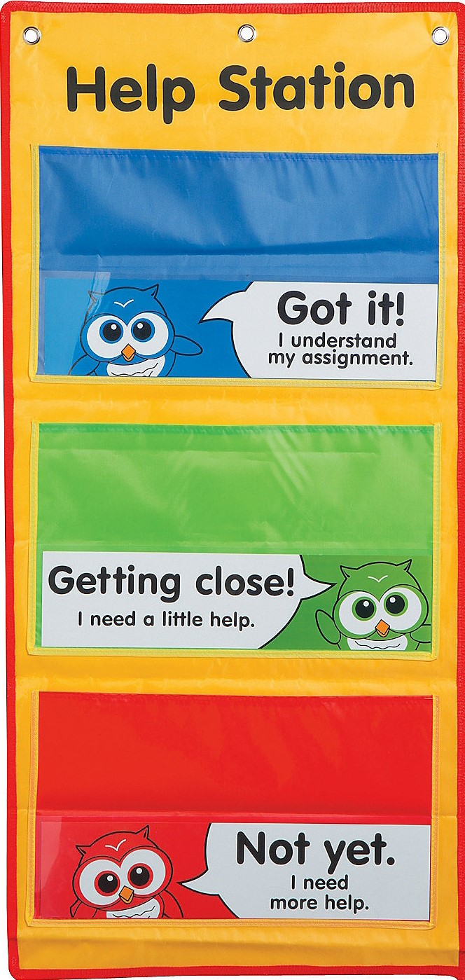
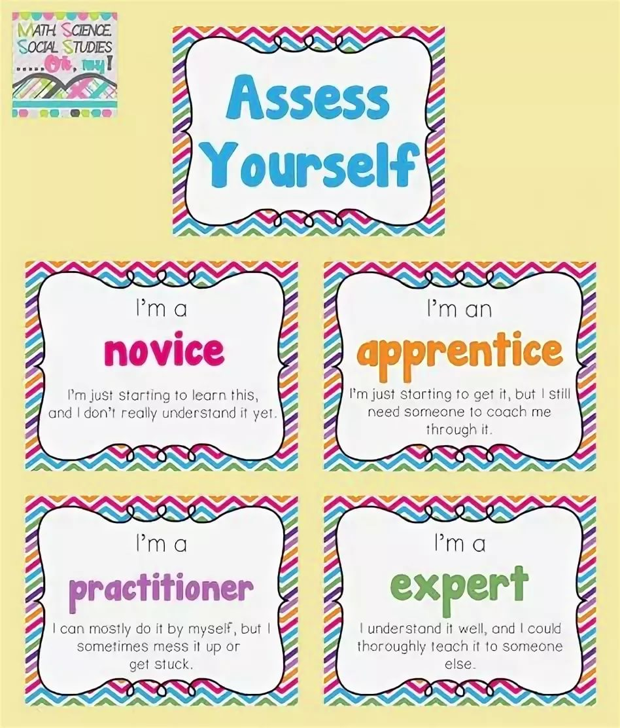
Self-assessment

Slide 24
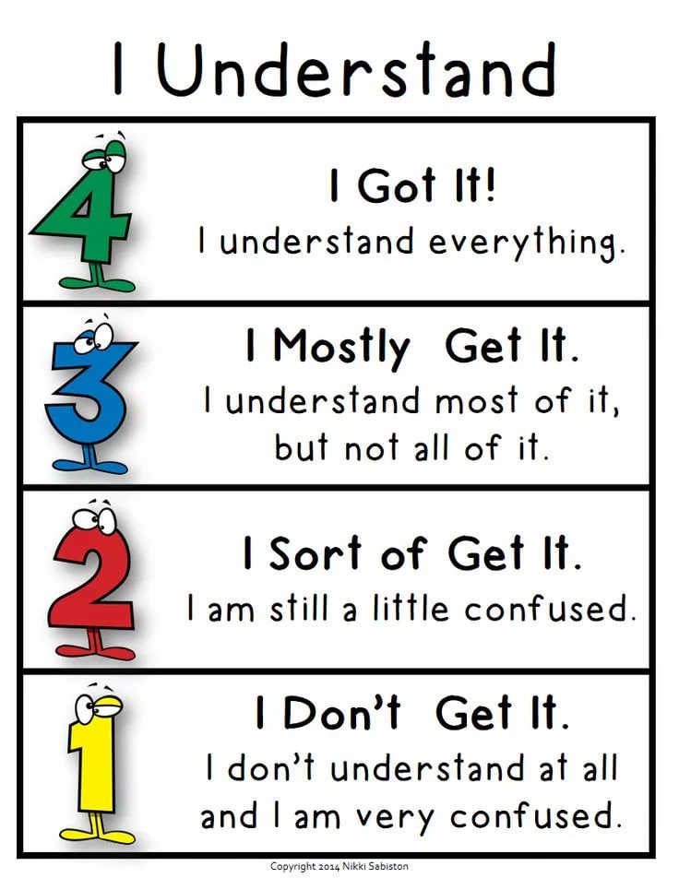
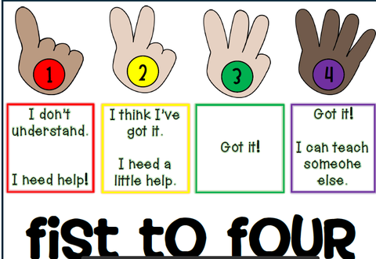
Self-assessment

Slide 25
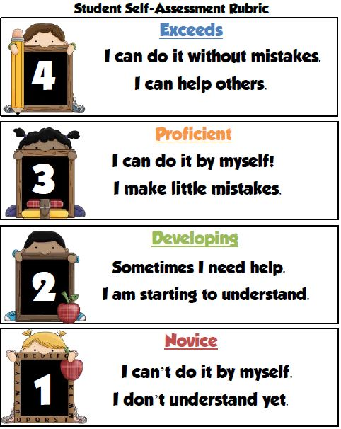
Self-assessment

Slide 26
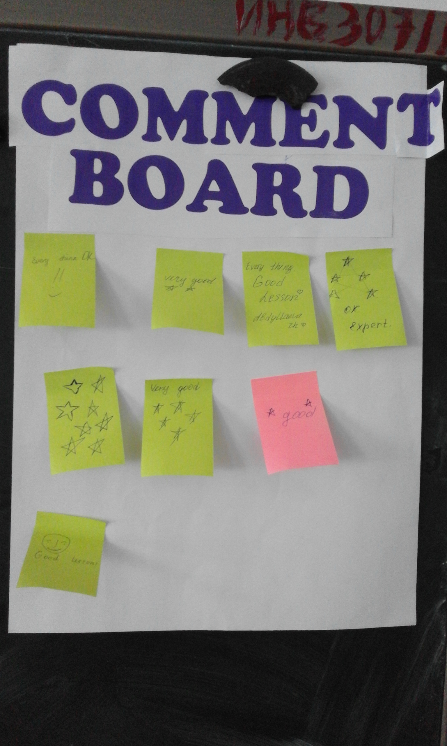
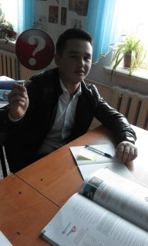

Slide 27
