Slide 1
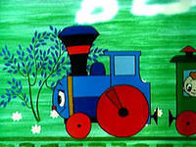

Slide 2
Sunday, Monday, Tuesday too.
Wednesday, Thursday just for you.
Friday, Saturday that's the end .
Now let's say those days again!
Sunday, Monday, Tuesday, Wednesday, Thursday, Friday, Saturday!

Slide 3
Let’s sing!
Seven days,
There are seven days!
Seven days,
Seven days a week!

Slide 4
Let’s sing!
Sunday, Monday - seven days!
Tuesday, Wednesday - seven days
Thursday, Friday - seven days!
Saturday - seven days!

