Slide 1
A House Advert
(Реклама дома)
урок английского языка, 6 класс,
УMK Ю. Е., Ваулиной ДЖ. Дули
Автор: Жаглина Татьяна Владимировна, учитель английского языка
МБОУ гимназии №19
имени Н.З.Поповичевой
г. Липецка

Slide 2
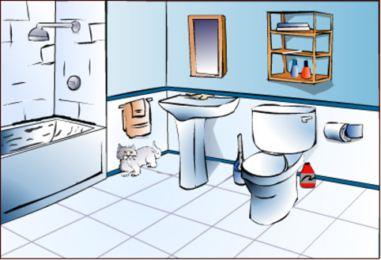
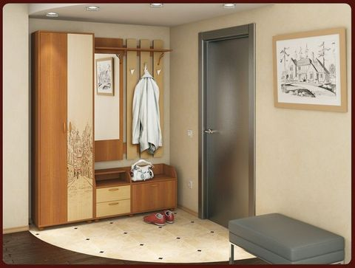
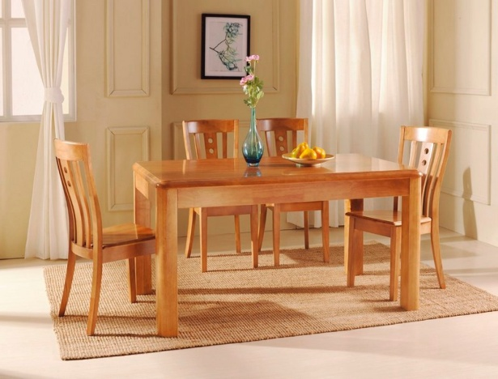
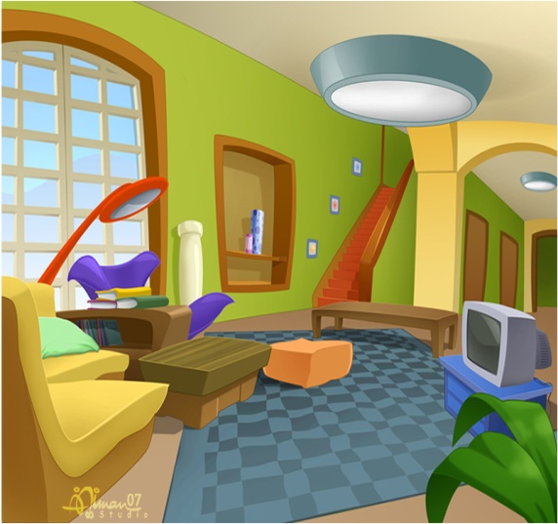
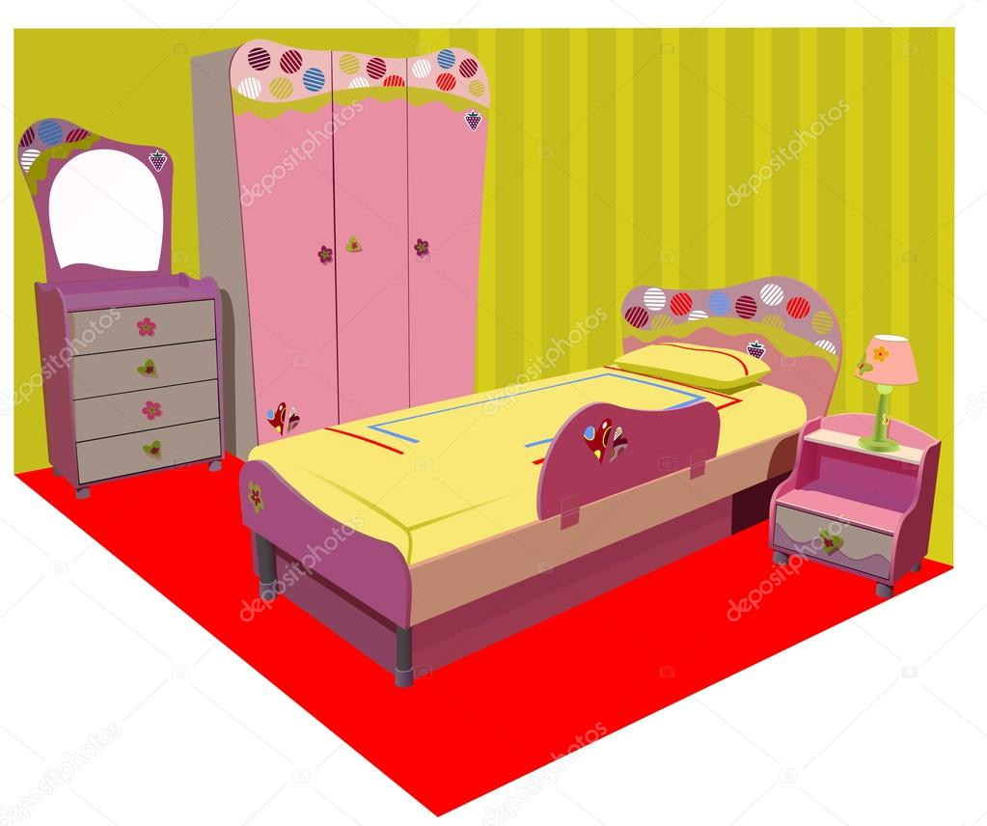
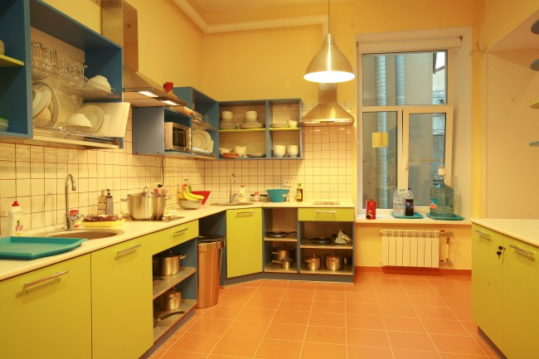
2
1
3
a bedroom
a living room
a kitchen
a bathroom
a dining room
a hall
4
6
5

Slide 3
COST PER WEEK: £ 300 per week
ROOMS: 1 big bedrooms living room kitchen bathroom
ADDRESS: 2 3 Road, Saltburn
SHOPS NEAR COTTAGE: 4 greengrocer's post office
AVAILABLE: 5 and August
Summer Holiday Cottage
3
10
Beach
bakes
July

Slide 4
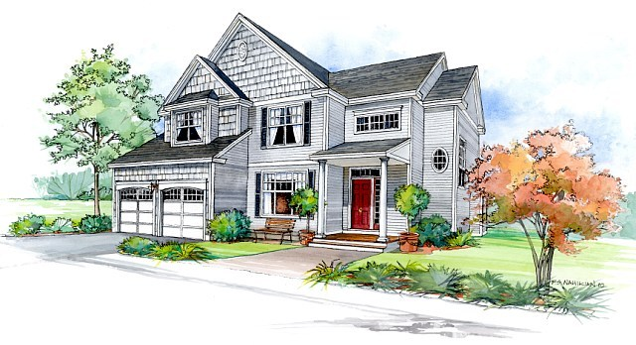
A House Advert
Call 7729689
for more information

Slide 5
Which of the following can you find in the advertisement?
where it is (location) | how big it is (size)
name of the street | rooms and furniture
outside | whose house it is
money per month (rent) | telephone number for information
√
√
√
√
√
√
√

Slide 6
Fill in the missing nouns:
Location | quiet street beautiful
Rooms | spacious small modern cosy
Outside | lovely huge
Furniture | comfortable wooden
country town
living room
dining room
kitchen
bedrooms
(front) garden
garden
armchairs
wardrobes

Slide 7
To write an advertisement for a house for rent we write how is and . We start our advertisement by saying is (location) and it is (size). Next we write how many there are and what room. Then we of the house. We end the advertisement by for more information.
Writing Tip
much the rent
the exact address
where the house
how big
rooms
there is in each
describe the outside
giving a telephone number

Slide 8
1 What's your address?
2 How much is the rent?
3 Where exactly is your house?
4 How big is it?
5 How many rooms are there?
6 What is there in each room?
7 What is there outside your house?
8 What is the telephone number people can call?
Answer the questions:
USE:
• 2,Green Street • 1832897 • £200/week • 7 • Quite spacious
• A small garden • A bath, a cooker... • Next to the park
.

Slide 9
For rent : ..............................................
Address : .............................................. location, size, rooms, furniture, outside
Call : ........................ for more information.
Plan

Slide 10
USE:
• 2,Green Street
• 1832897
• £200/week
• 7 rooms
• comfortable armchairs and a sofa
• a small garden
• a bath, a shower
• next to the park
• three spacious bedrooms, a living room, a dining room
• a kitchen and a bathroom
• wooden wardrobes
• cooker and a fridge

Slide 11
For rent: £200/week.
An attractive house next to the park suitable for a family of four. Located at 2, Green Street, it is large, with three spacious bedrooms, a living room, a dining room, a kitchen and a bathroom. In the living room there are comfortable armchairs and a sofa. The large kitchen has got a new cooker and a fridge. The bedrooms have got wooden wardrobes and the modern bathroom has got a bath and a shower. Call 1832897 for more information.
Check your answers:

Slide 12
This beautiful, fully-furnished cottage is in the countryside 5km from the village of Priston. On the ground floor is the kitchen, a large living room 1) ............... A dining room. The kitchen is modern, 2)...........fitted cupboards 3)........... an electric cooker. There are three bedrooms with fitted wardrobes on the first floor 4)............. a bathroom 5).............. a shower. The cottage has a large garden 6)...............there is a new garage 7)...............space for two cars.
Fill in with or and:
FOR RENT
BEAUTIFUL COTTAGE
and
with
and
and
with
and
with

Slide 13
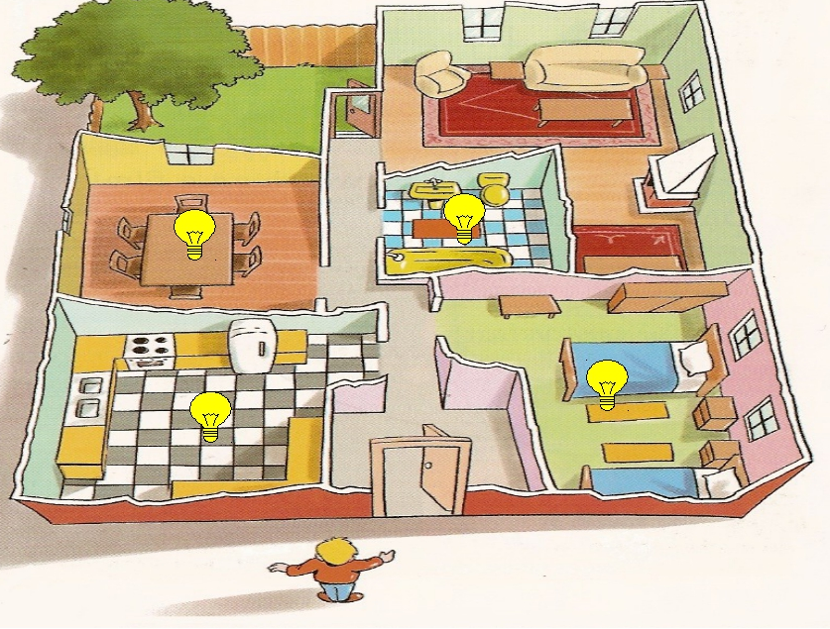
Ex. 4 p. 15: Use the information in the box to write an advert for the flat below. Use a plan, Ex. 2 p. 15, your adverts, as a model.
YOUR HOMEWORK

Slide 14
Интернет источники:
http://static5.depositphotos.com/1003854/460/v/950/depositphotos_4607410-Colorful-children-room-vector-illustration.jpg - изображение спальни
http://xn--80afvdoancgk9l.xn--p1ai/pic/tov/ed38e27d22700be5bd39a41a6b9dff76.jpg - изображение столовой
http://mebelnadom.ru/img/nizhegorodmebel/prihojaya_gloria/comps/5244.jpg - изображение прихожей
https://fs00.infourok.ru/images/doc/252/256857/img10.jpg - изображение плана квартиры
http://www.homeenglish.ru/pic/bathroom.jpg - изображение ванной комнаты
http://readytospeak.ru/wp-content/uploads/2016/01/house-drawing.jpg - изображение дома
http://orig07.deviantart.net/efe3/f/2008/331/e/9/e9233209245b69d5818b42694c7b77b4.jpg - изображение гостиной
http://www.spbtravel.ru/pic/photo/catbig_576_25.jpg - изображение кухни

