Slide 1
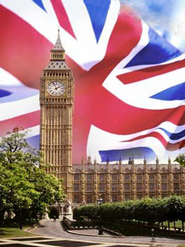
Travelling in Britain
Путешествие в Великобританию

Slide 2
Цели урока:
Обобщить лингвострановедческий материал, углубить и расширить
знания по теме.
2. Совершенствовать умения и навыки практического владения английским языком по данной теме по всем видам деятельности:
аудированию, говорению, чтению и письму.
3. Повысить интерес к изучению иностранного языка.

Slide 3

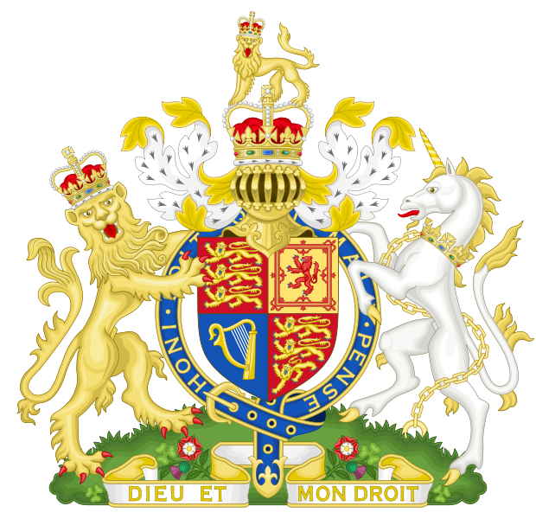
Parks, museums, gallerys
London
capital
English
places of interest
language
Christmas Easter,
St Valentine`s Day
244 308 km2
territory
holidays
London, Belfast, Liverpool, Manchester, Bristol
Monachy
57 millions,
political system
population
main cities

Slide 4
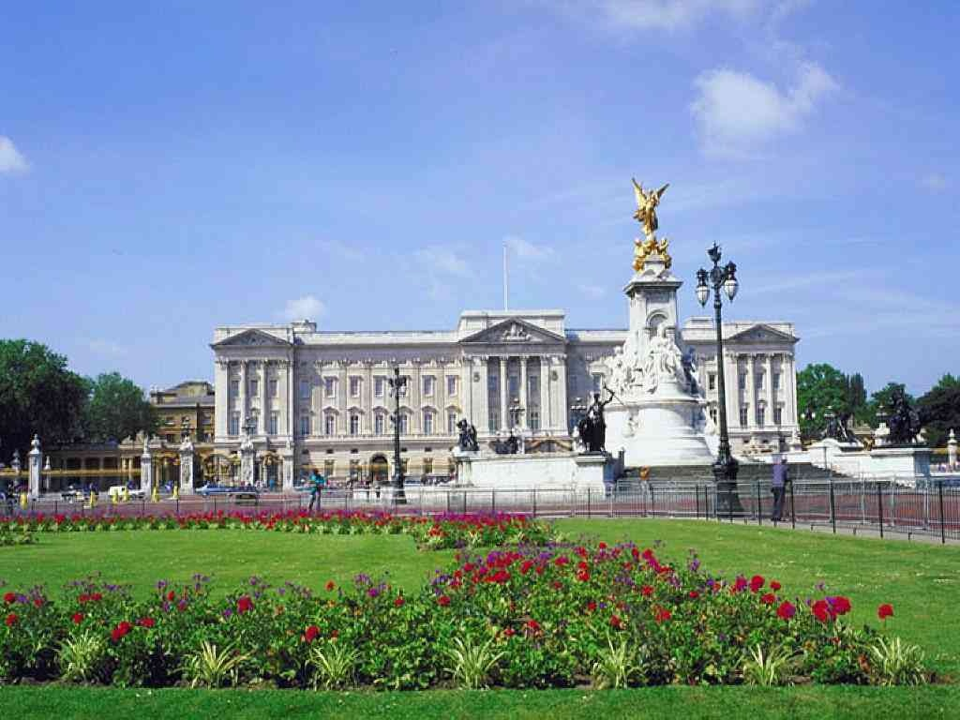
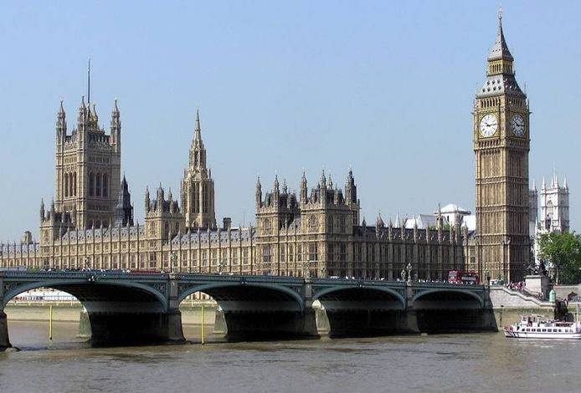
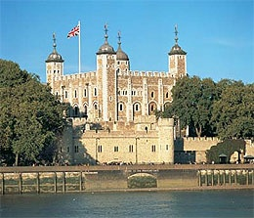
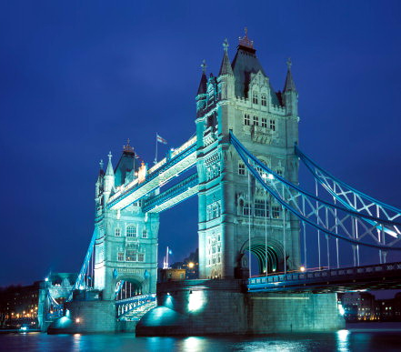
The United Kingdom of Great Britain and Northen Ireland

Slide 5
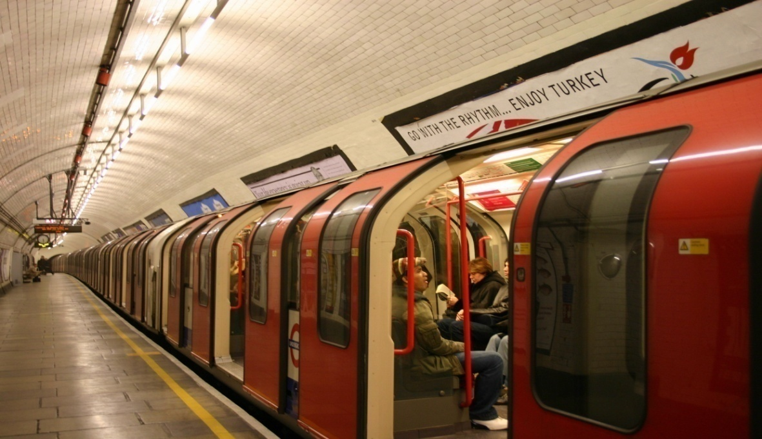
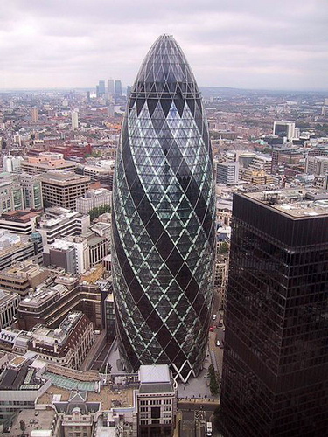
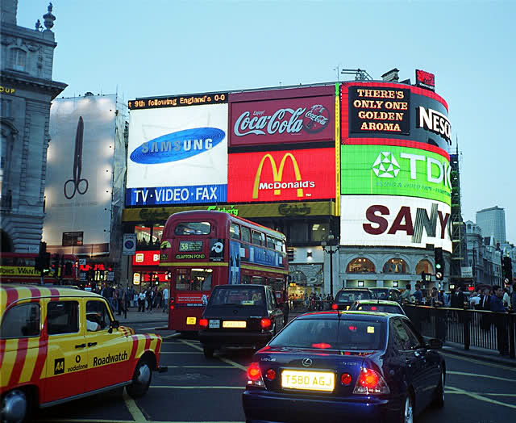
Modern
London

Slide 6
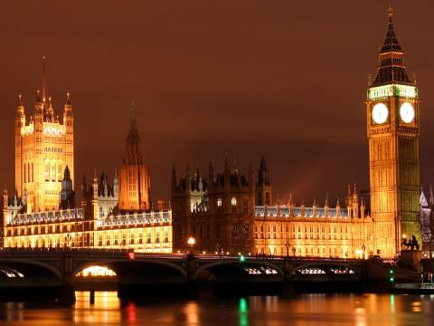
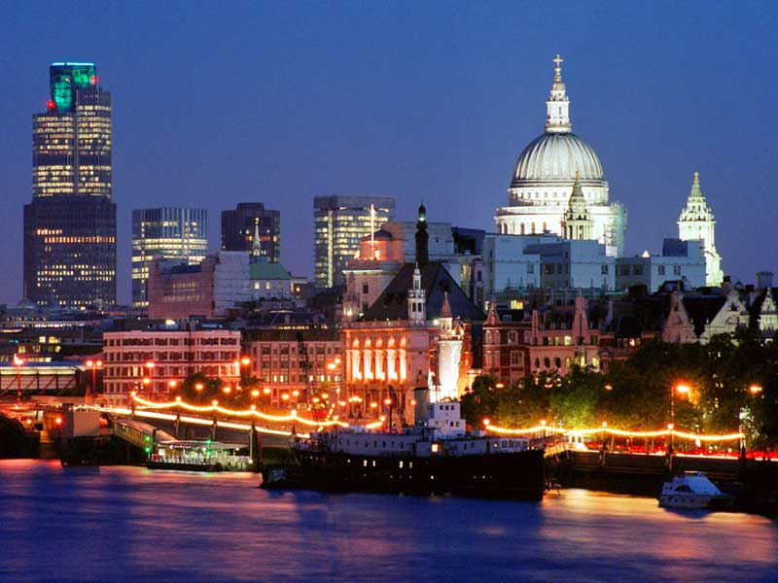
Welcome to Great Britain
London is the capital of
Great Britain.
It stands on the river Thames.
It is very old city .
It is two thousand years old.
Now London is a big port and a beautiful city.
About seven million people live here.

Slide 7
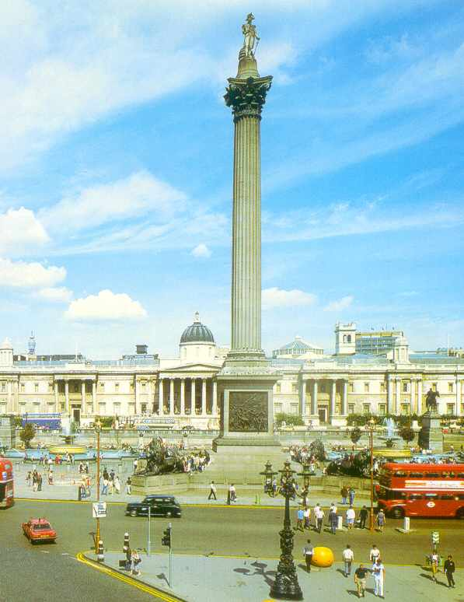
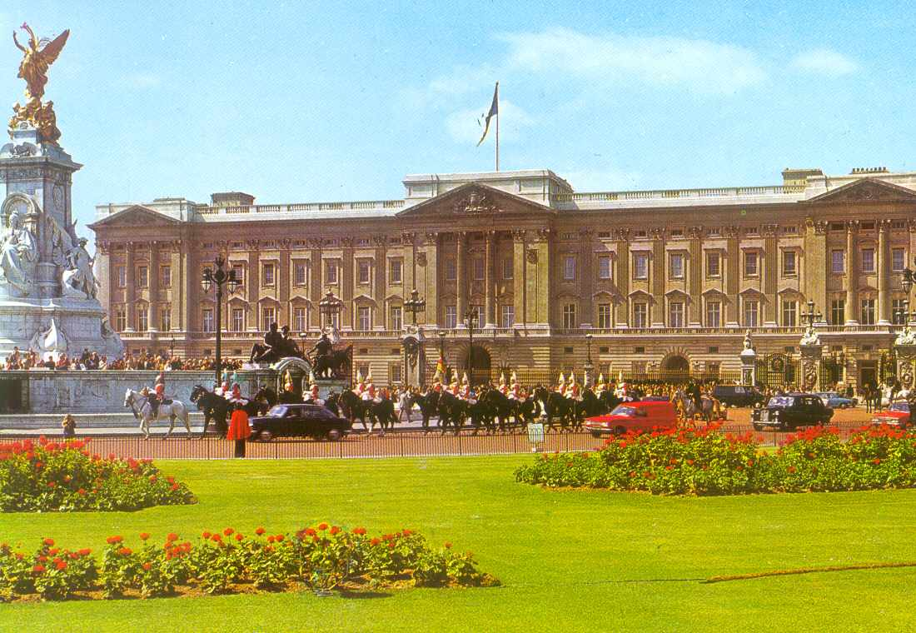
Trafalgar Square Buckingham Palace
In the middle of the square This is the Queen’s home.
there is Admiral Nelson’s Column

Slide 8
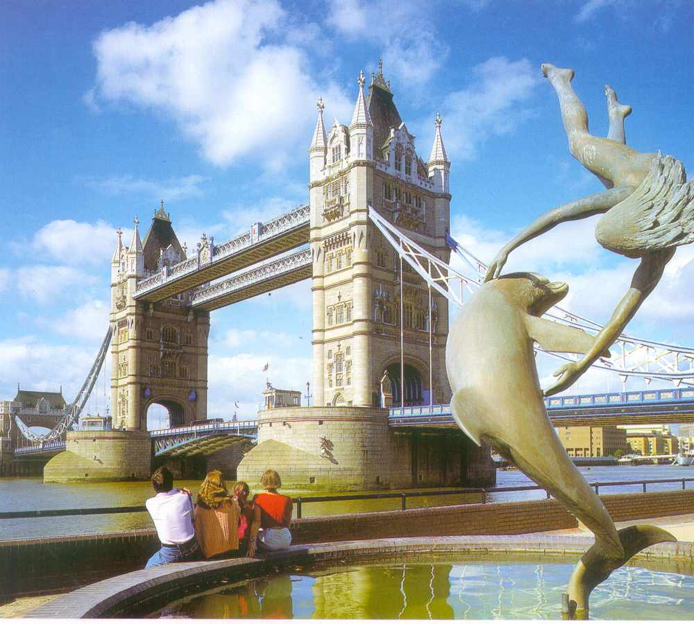
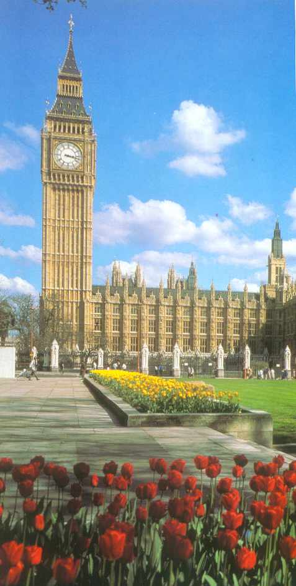
Tower Bridge - Big Ben-
the most famous bridge in London the big clock tower

Slide 9
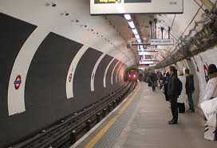
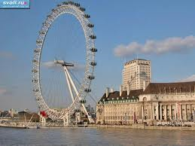
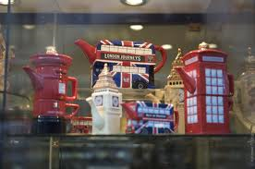
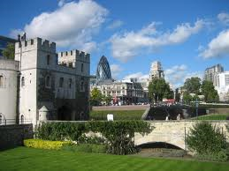
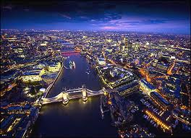
ENJOY SIGHTSEEINGS of LONDON !!!

Slide 10

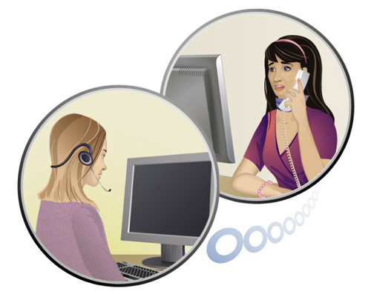
Travel agency
Hi!
hello!

Slide 11
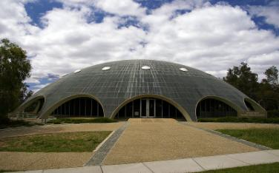
Грамматические задания
Дать три формы следующих глаголов
Write -
Know -
Teach -
Think -
Ride -
Drive -
Fly -

Slide 12
Задать специальный вопрос к данным предложениям:
He travelled by train.
She saw the Tower of London.
They stayed at the best hotel.
You came back in August

Slide 13
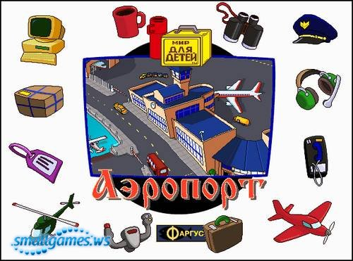
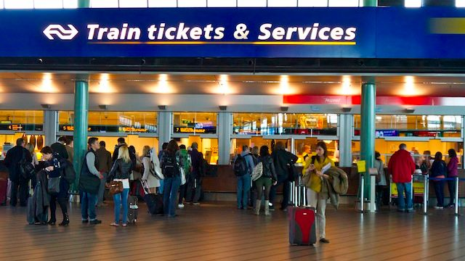
Airport

Slide 14
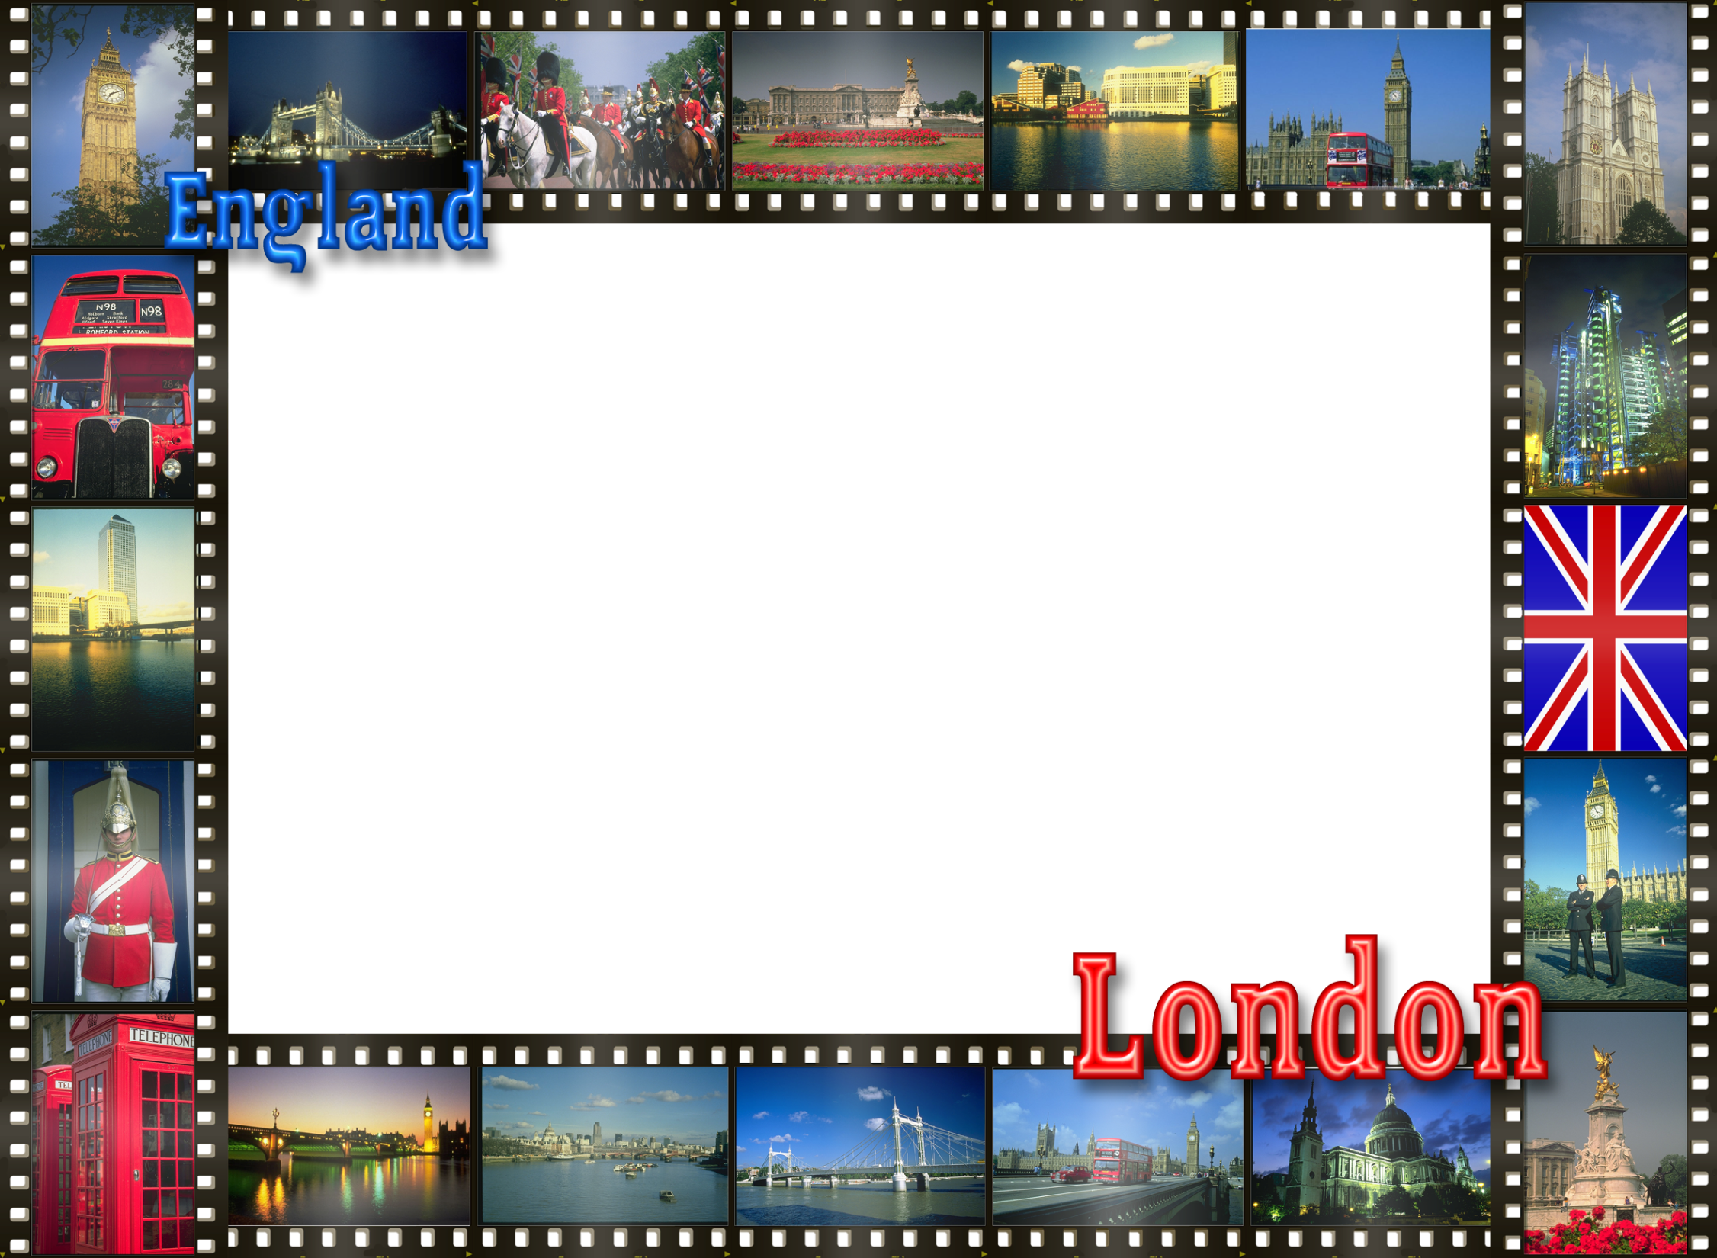
Ответить на вопросы:
When did you travel last?
Where did you go?
What did you see there?
Did you enjoy your trip?

Slide 15
Выбрать подходящее слово:
(a lot / much ) forests
(some / any ) parks
(a few / a little ) rooms
(many / much ) people
(few / little ) water
A lot
some
a few
many
little

Slide 16
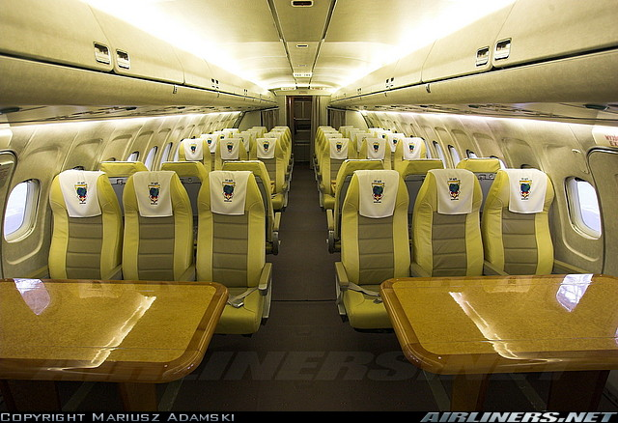
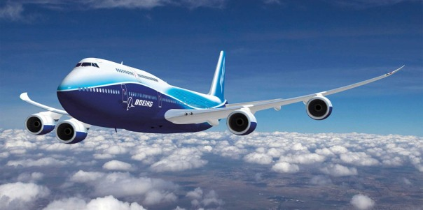
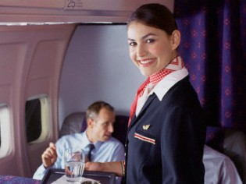
In the plane

Slide 17
Questions
1) What is the unpleasant aspect of the English weather?
2) What trees are typical for the forests of Great Britain?
3) What is grown in Great Britain?
4) Who is the Head of State in Great Britain?
5) What do you know about the Whitehall in London?
6) What is the most ancient historic monument in London?

Slide 18
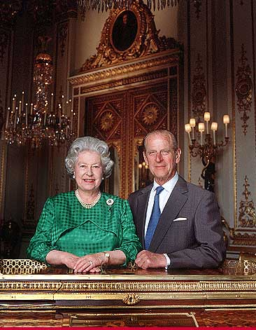
Образовать степени сравнения прилагательных:
Clever –
High -
Hot -
Happy -
Important -
Good -
Famous -
Bad -

Slide 19
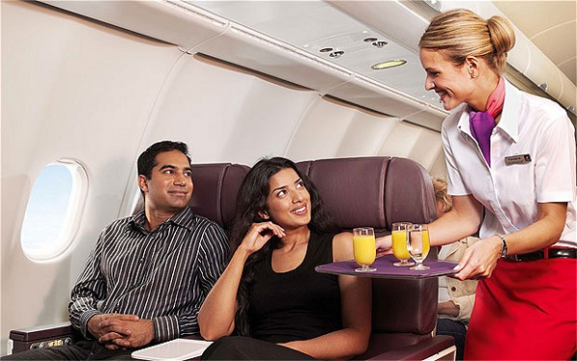
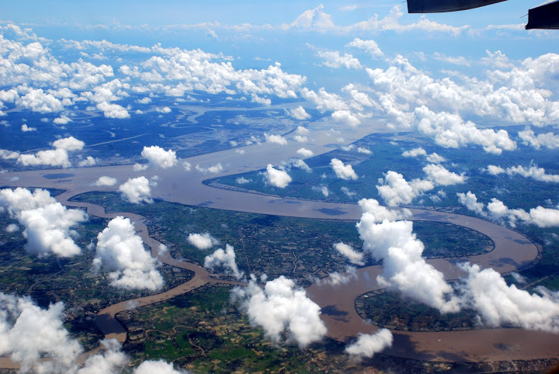

Slide 20
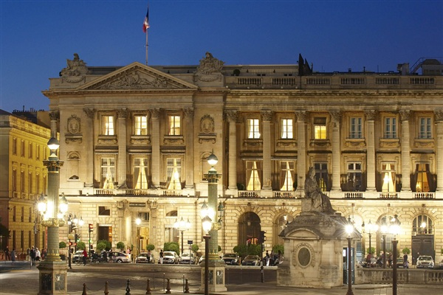
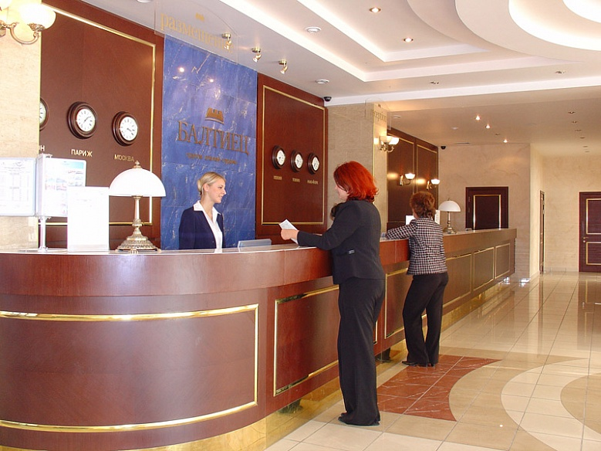
Hotell

Slide 21
crossword
1
H E A T H ROW
B R I T T A N I A
2
3
S P R I N G
4
L O L L I P O P M A N
G R E E N P E A C E
5
6
S I X T E E N
L O N D O N
7

Slide 22
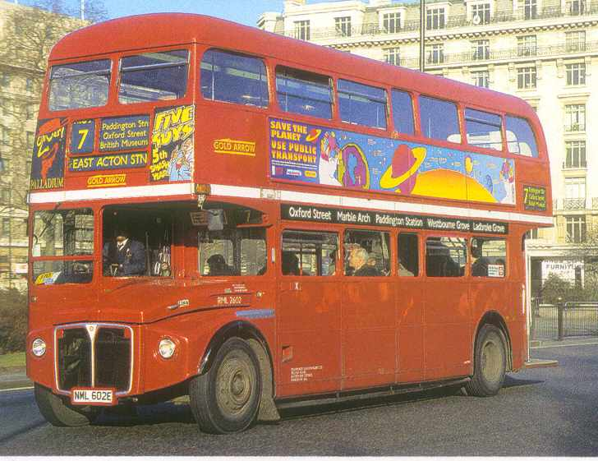
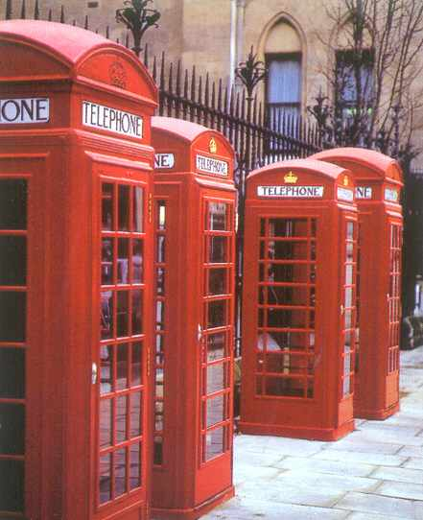
Double-deckers Telephone booths
There are big red buses called From here you can call your friends.
double-deckers in London.

Slide 23
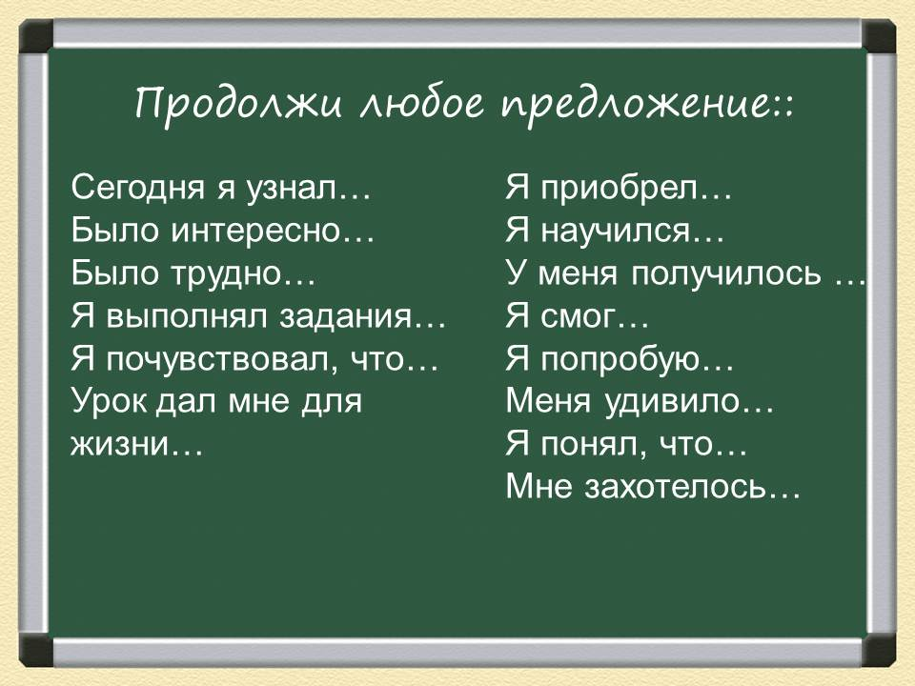

Slide 24
HOME WORK
To write several sentences about your holidays

